Slide 1
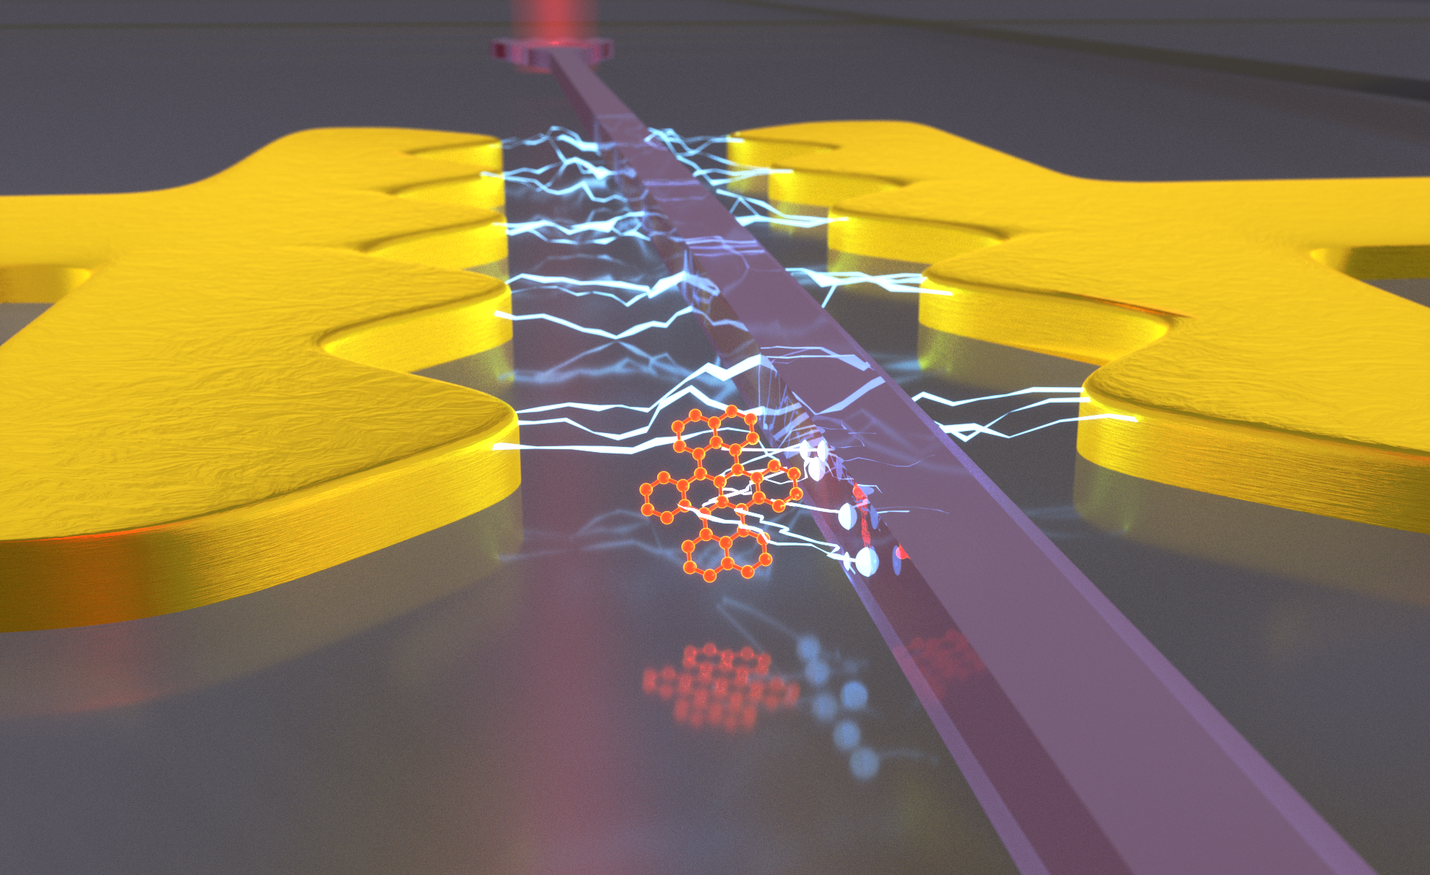
Scientific 3D-renderings
With blender
Dominik Rattenbacher Max Planck Institute for the Science of Light

Slide 2
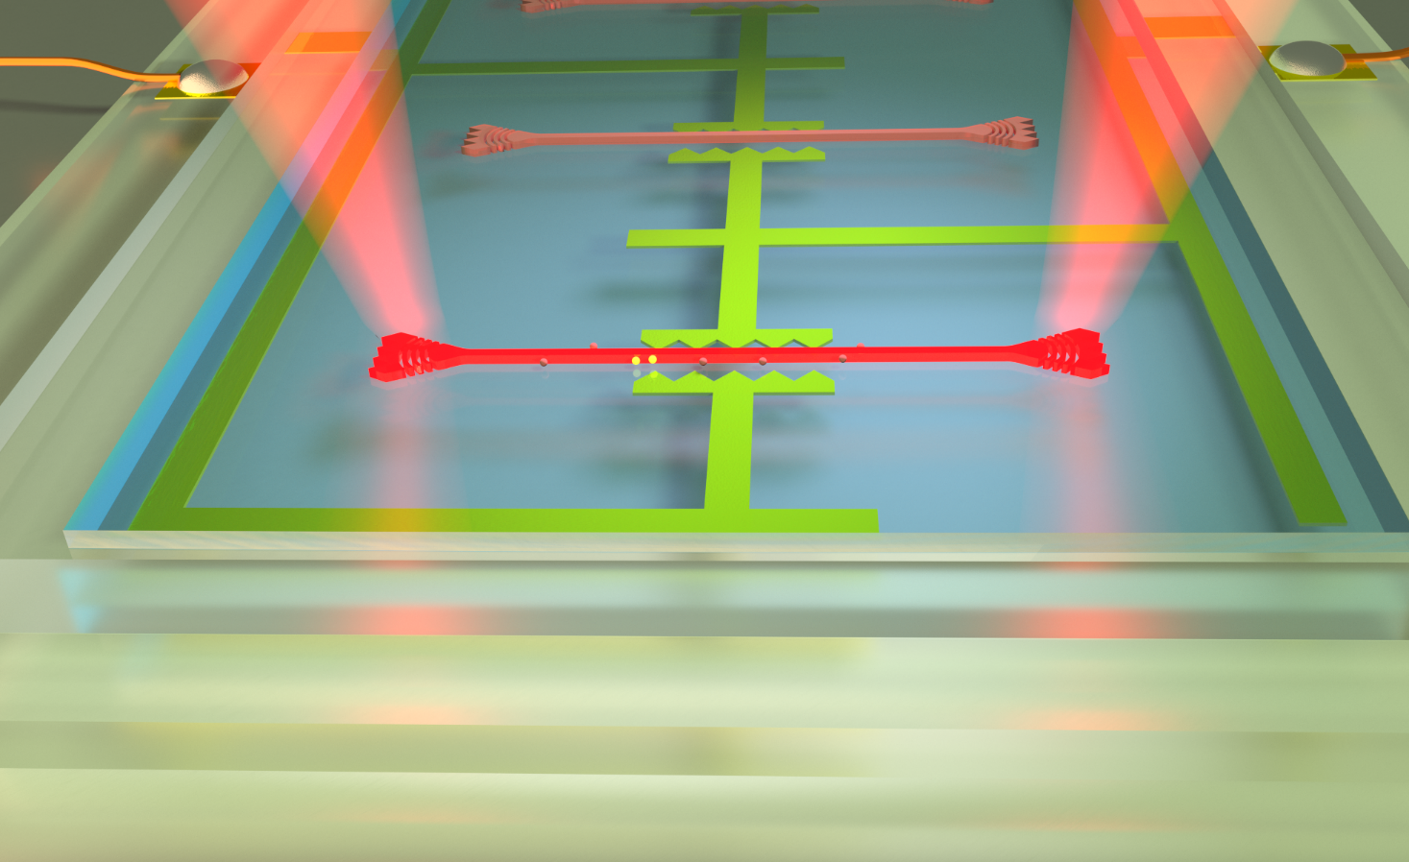
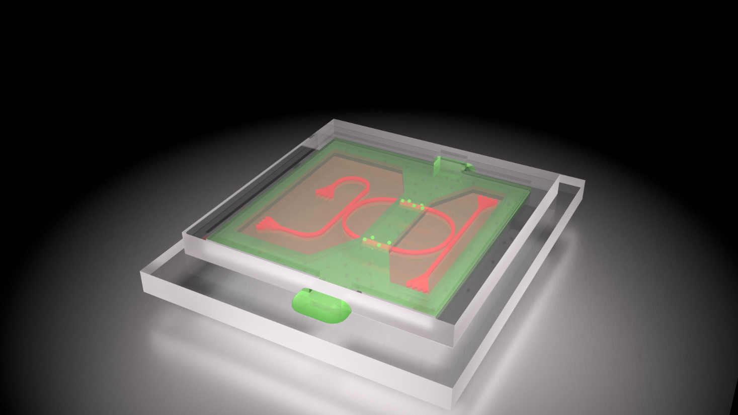
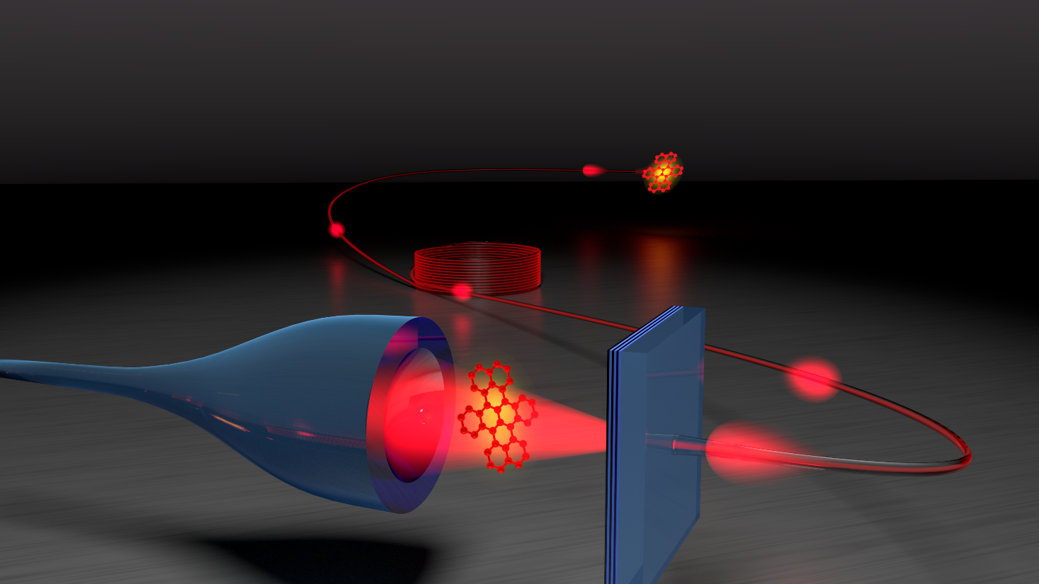
Notes:
Open Source
Quite powerful: Supports GPU rendering, Photorealistic images, python API, etc.
Good documentation, countless youtube channels with tipps

Slide 3
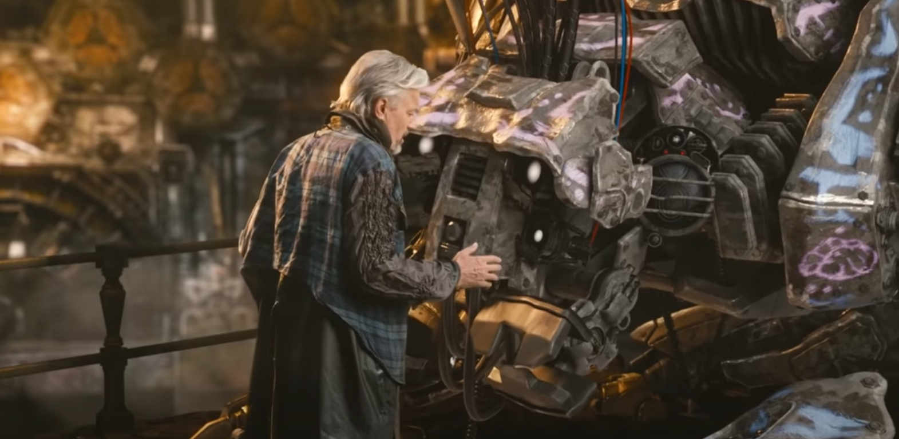
A bit of history
Created 1994 by Ton Roosendal for his 3D animation Studio NeoGeo Idea get the “magical ability to create a whole world in a computer.”
Several intermediate companies, after a crowdfunding in 2002: open-source
Small core team at blender foundation in Amsterdam and a huge community drive the evolution of blender
Mission: “get the world’s best 3d technology in the hands of artists as open-source, and make amazing things with it.”
https://www.blender.org/foundation/history/

Slide 4
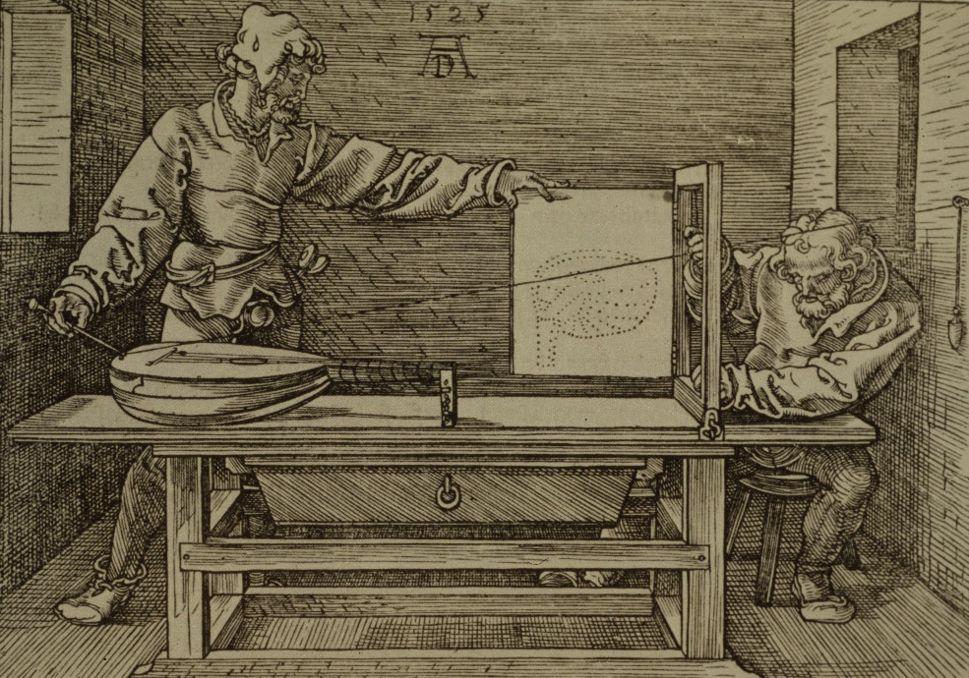
How does it work?*
Dürrer,“Underweysung der
Messung mit dem Zirckel
und Richtscheyt“ (1525)
*refers to the cycles render engine NOT to rasterization algorithms like Eevee https://en.wikipedia.org/wiki/Ray_tracing_(graphics)
Notes:
From series “4 books on measurement”

Slide 5
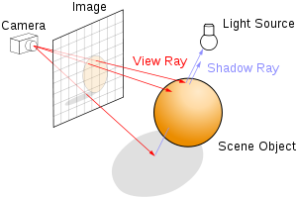
How does it work?*
*refers to the cycles render engine NOT to rasterization algorithms like Eevee https://en.wikipedia.org/wiki/Ray_tracing_(graphics)

Slide 6
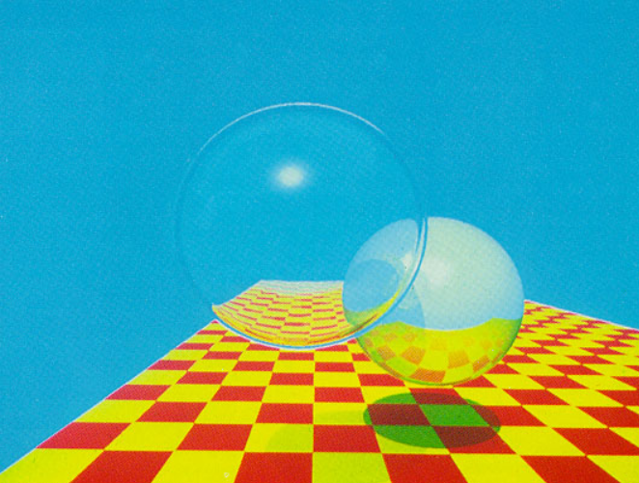
How does it work?
J. Turner Whitted 1980; https://dl.acm.org/doi/10.1145/358876.358882
74 min for 480x640 pixels with 9 bits per pixel

Slide 7
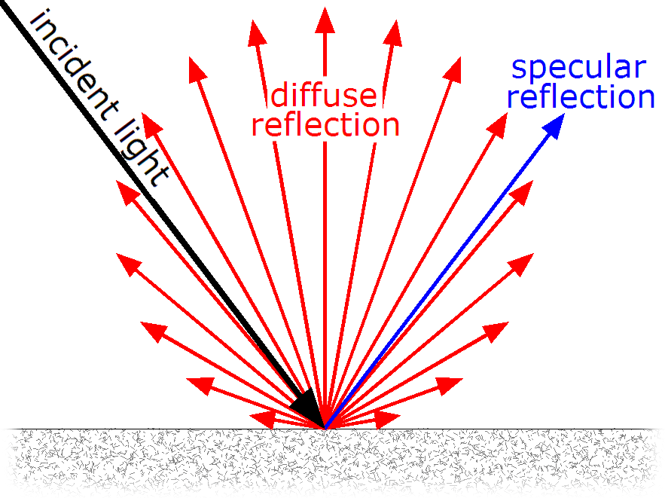
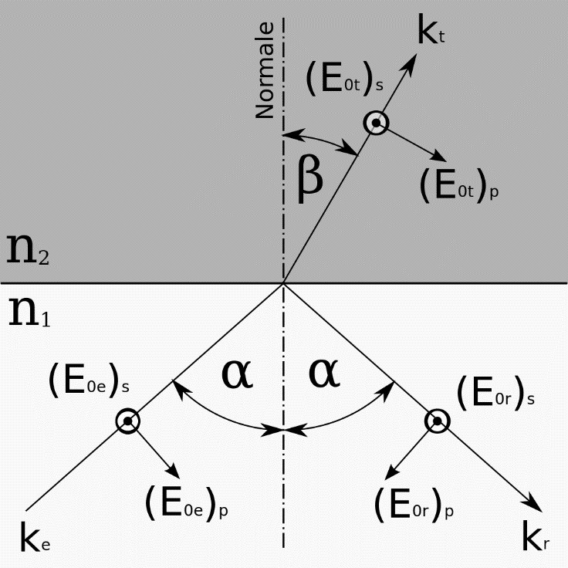
What can happen at an interface?
In principle the following effects are possible
Plus: Absoprtion, Transparency and Emission (i.e. object is partially a light source)
*
*Specular is called glossy in blender

Slide 8
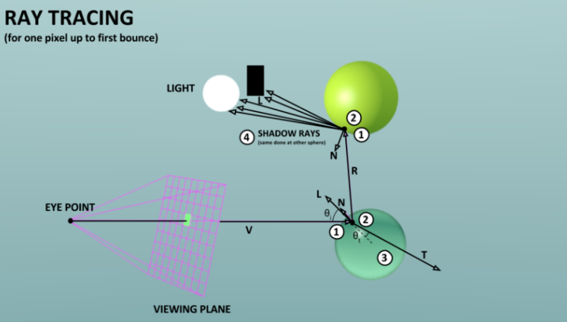
Trace the ray back to the light source!

Slide 9
How does it look in blender?

Slide 10
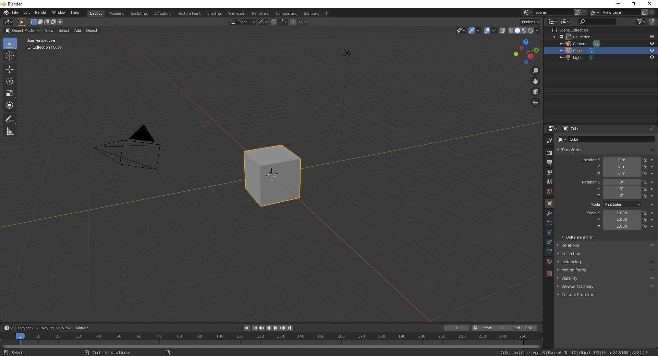
How does it look in blender??
Lightsource
Object
Camera

Slide 11
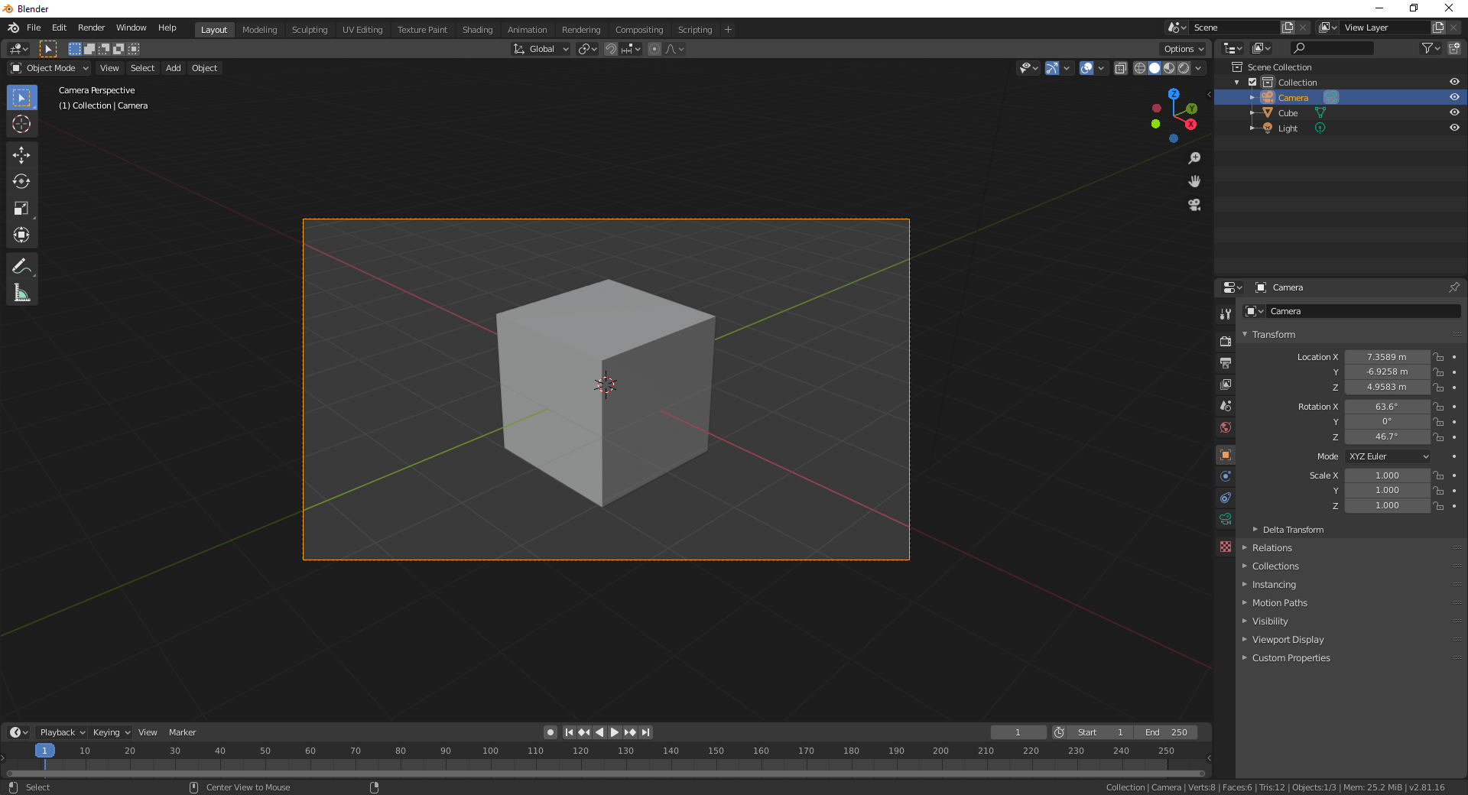
How does it look in blender??
Camera View:
Left-Click on camera
Crtl+NumPad0

Slide 12
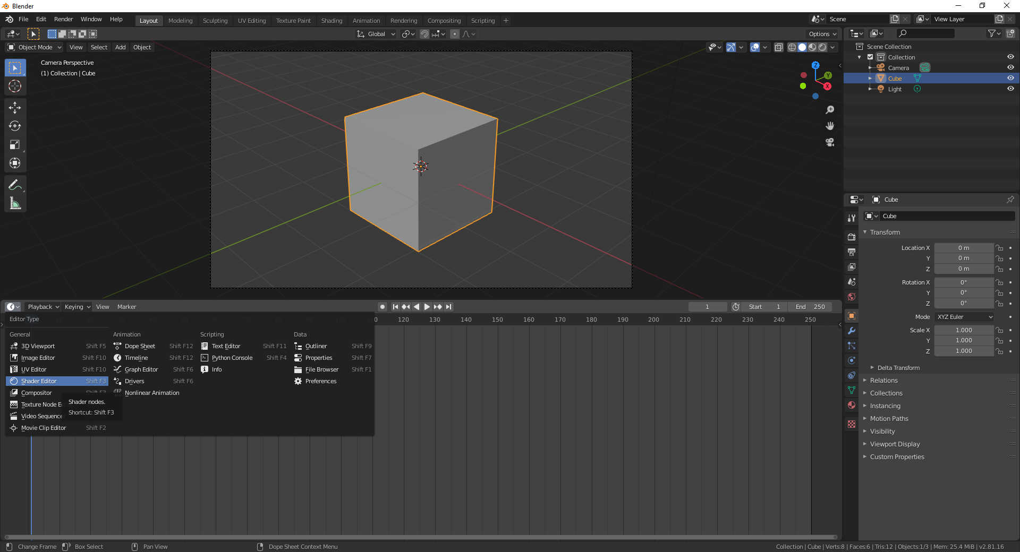
How does it look in blender??
Pull up second window And select shader editor

Slide 13
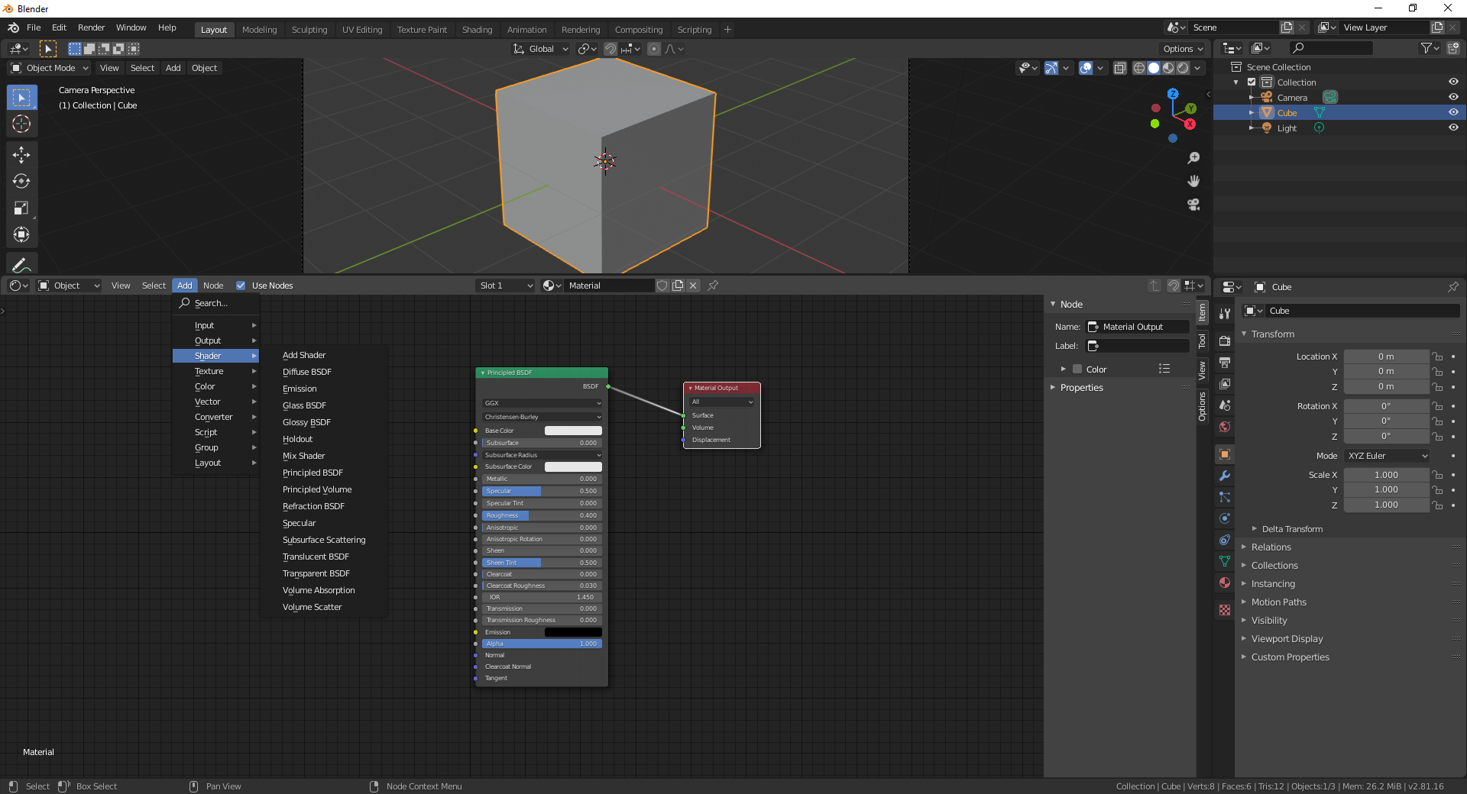
How does it look in blender??

Slide 14
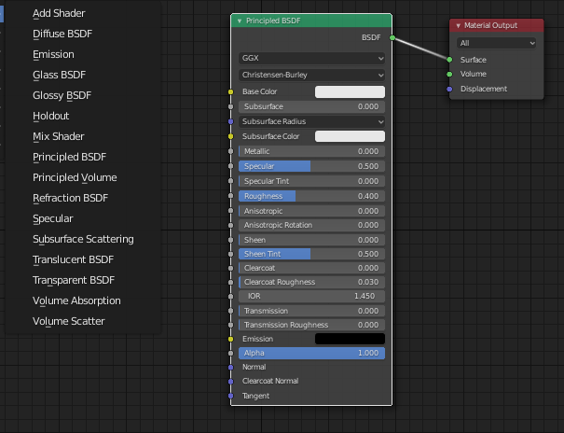
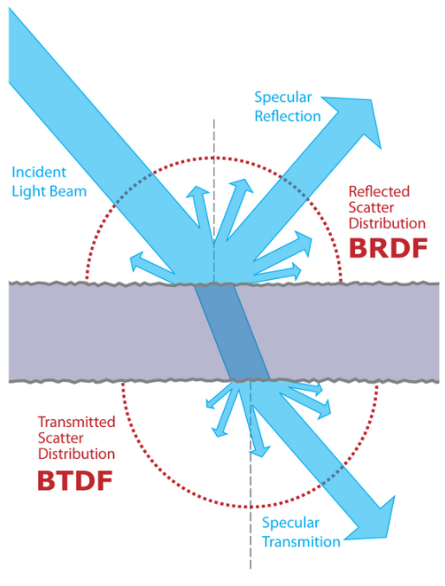
How does it look in blender?
BSDF=Bidirectional Scattering Distribution Function = BTDF+BRDF
Notes:
Bidirection because input and output angles are given it

Slide 15
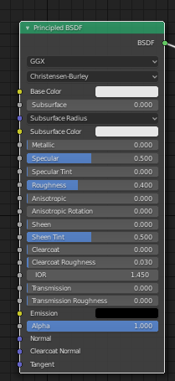
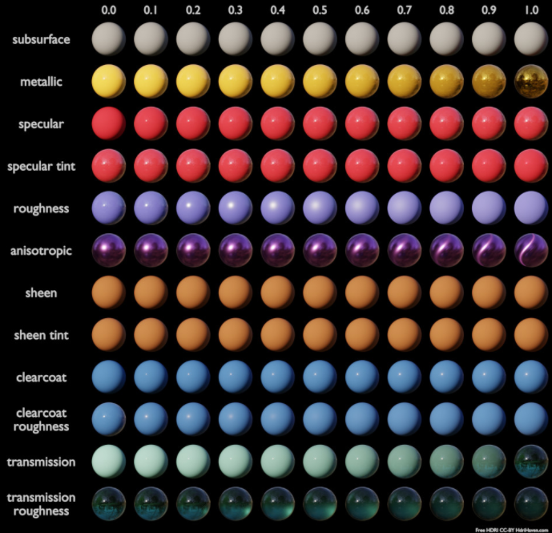
How does it look in blender?
https://docs.blender.org/manual/en/latest/render/shader_nodes/shader/principled.html
Notes:
Bidirection because input and output angles are given it

Slide 16
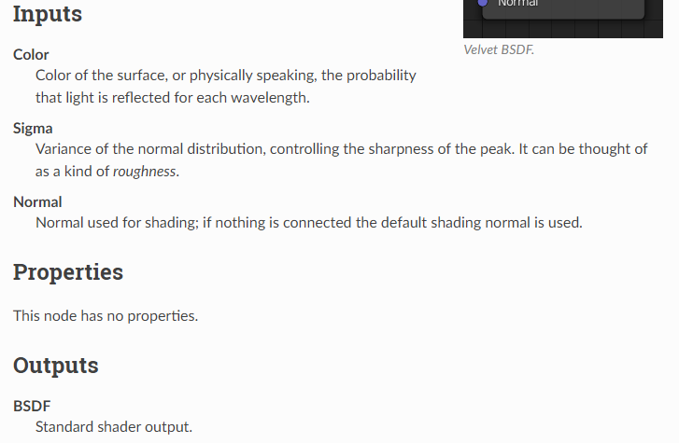
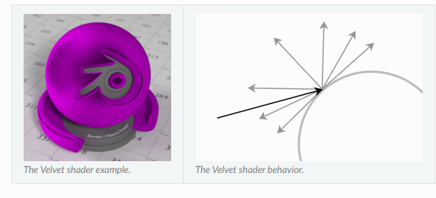
What to do, if you want to find something out?
https://docs.blender.org/manual e.g. velvet node:
Search on youtube; chances are very high that there is a tutorial for your problem (e.g. BlenderGuruOfficial has some very good tutorials)

Slide 17
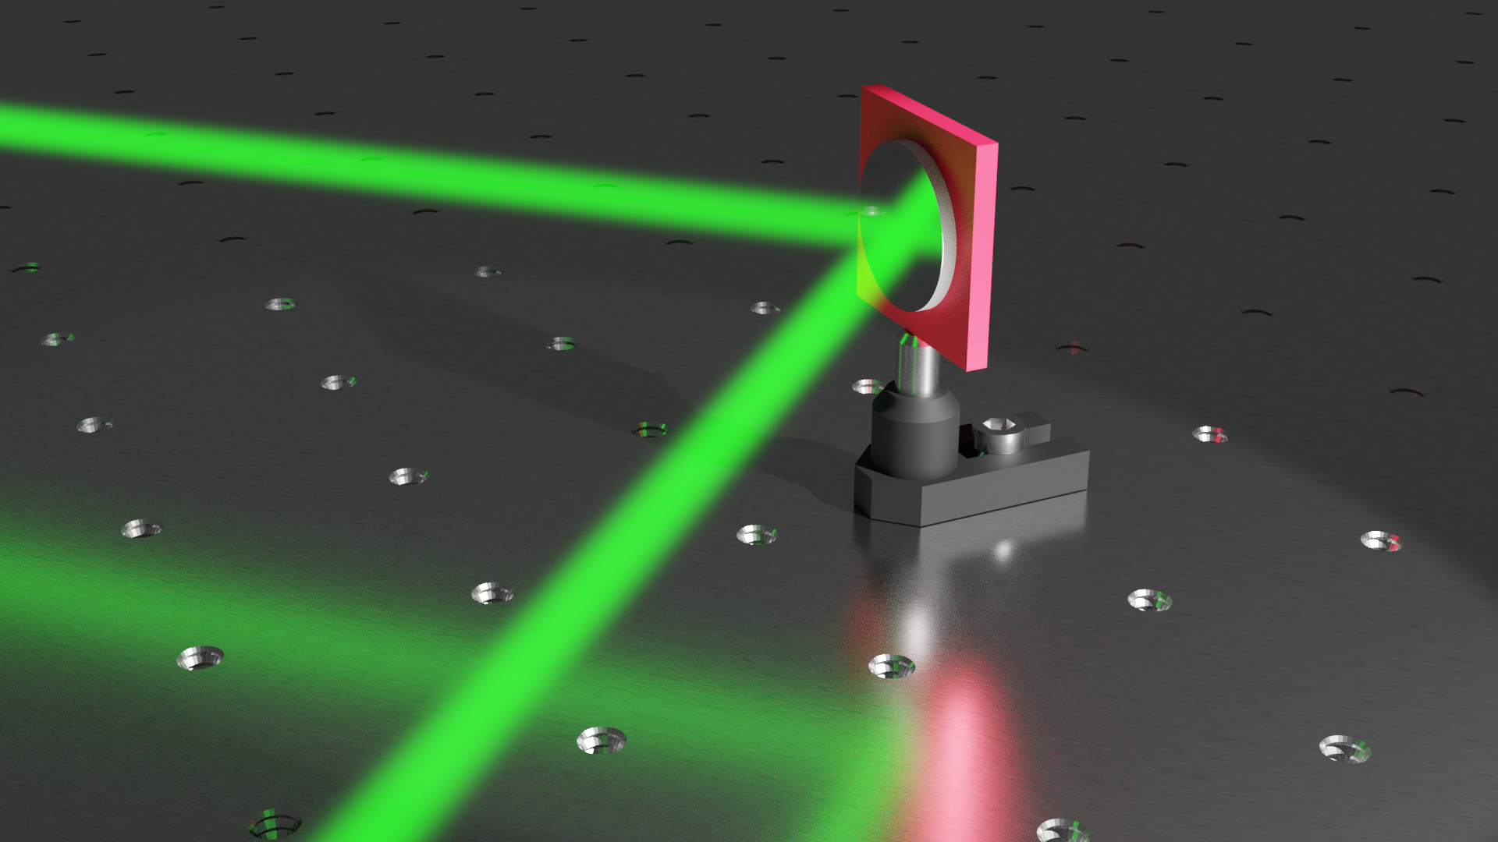
An Example?

Slide 18
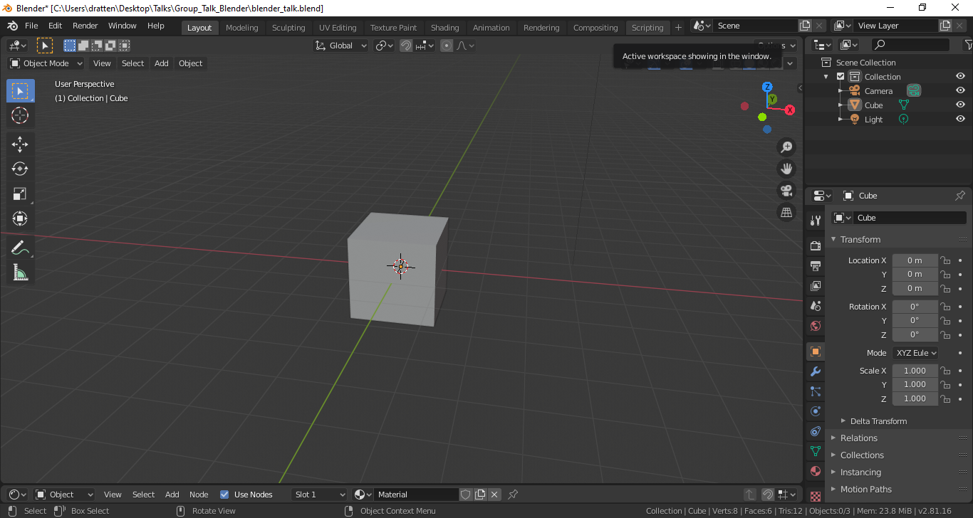
Step 1: Modeling?

Slide 19
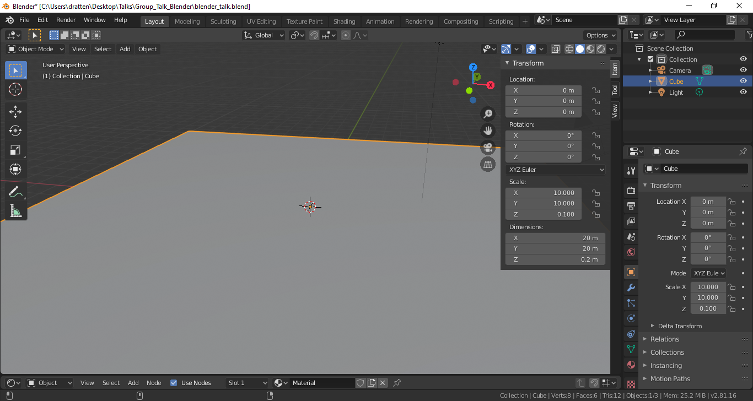
Step 1: Modeling?

Slide 20
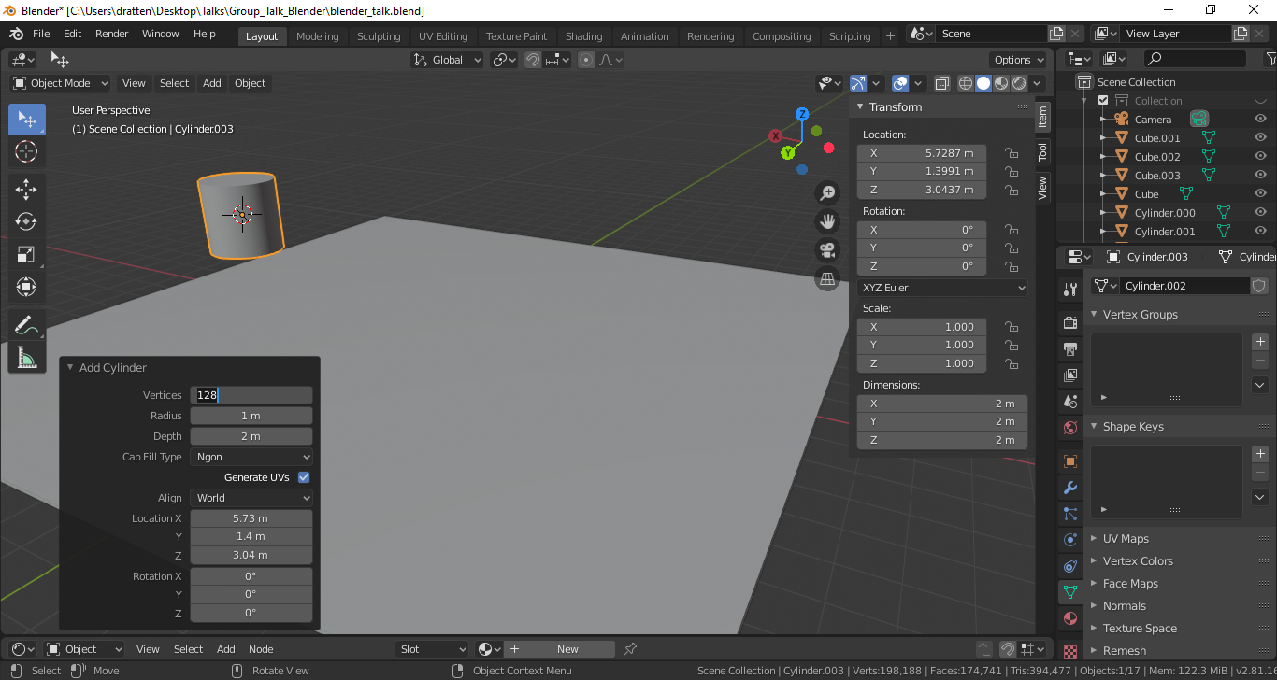
Step 1: Modeling?

Slide 21
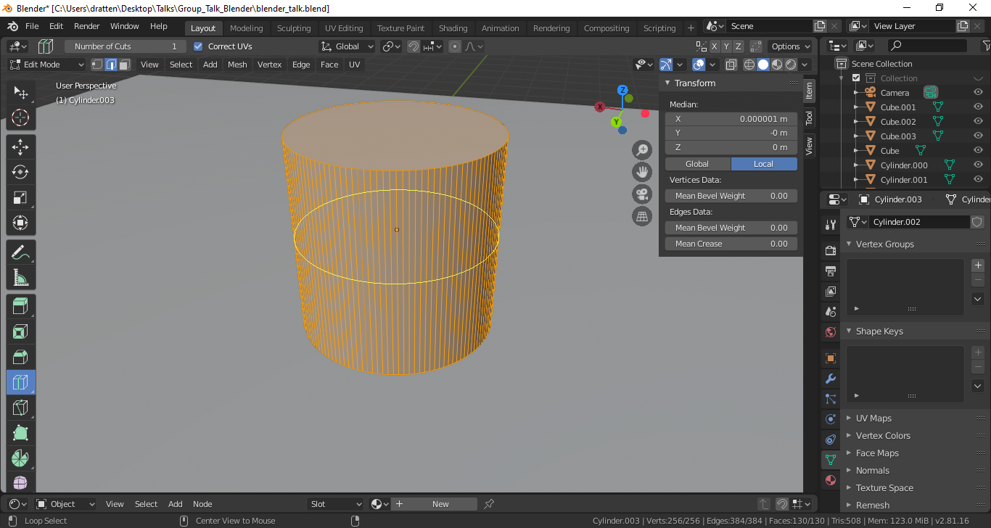
Step 1: Modeling?
Tab for edit mode

Slide 22
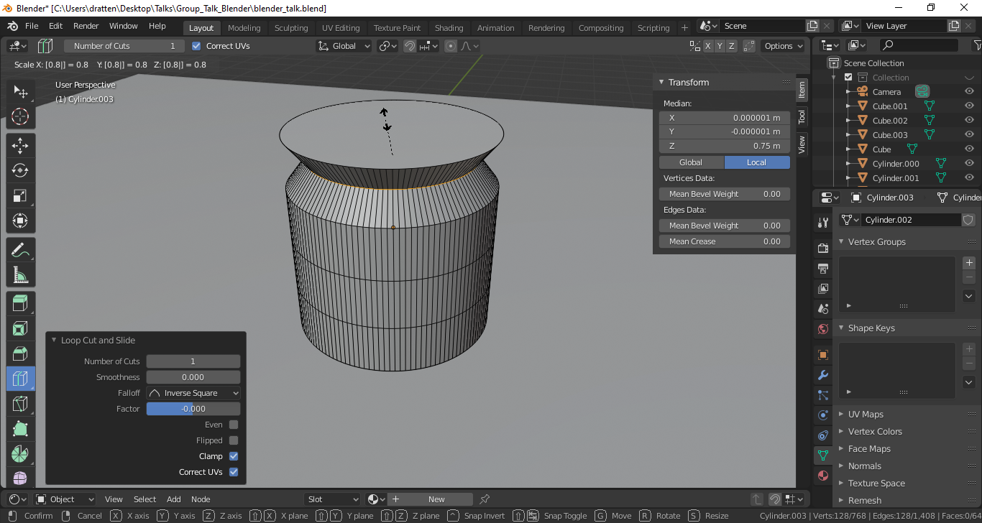
Step 1: Modeling?
S+0.8 for scaling the ring

Slide 23
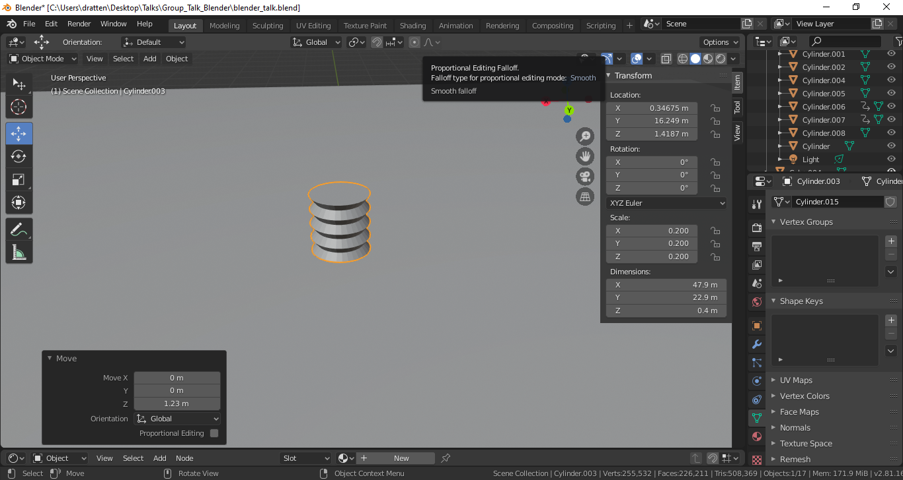
Step 1: Modeling?

Slide 24
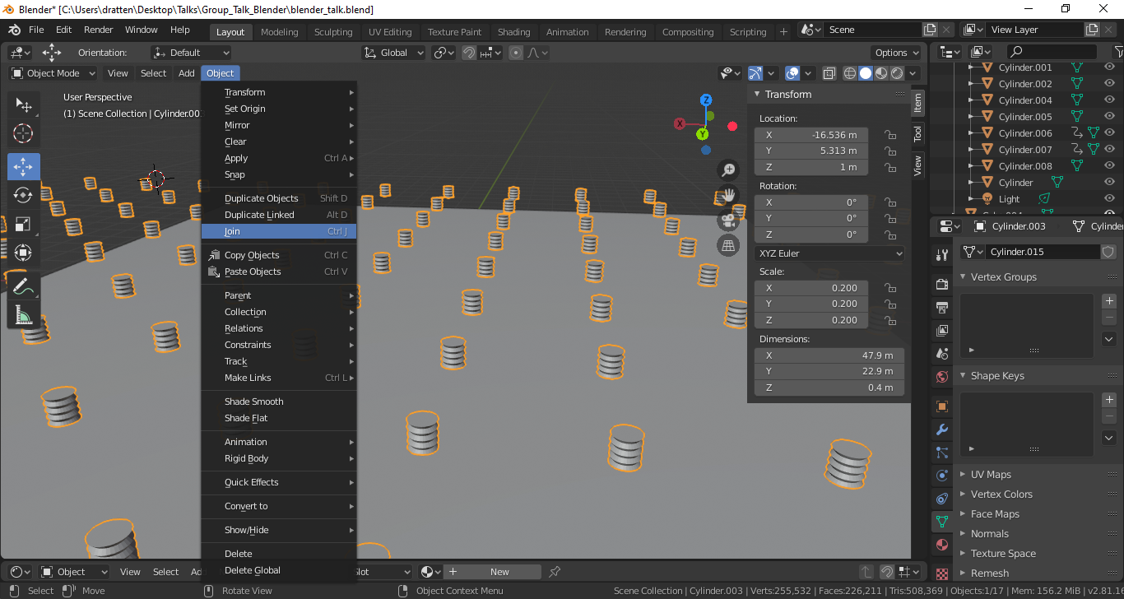
Step 1: Modeling?
Copy (Crtl C + V) and then join to new object

Slide 25
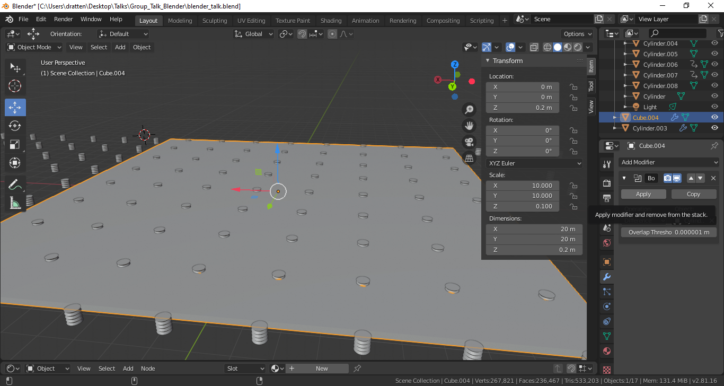
Step 1: Modeling?

Slide 26
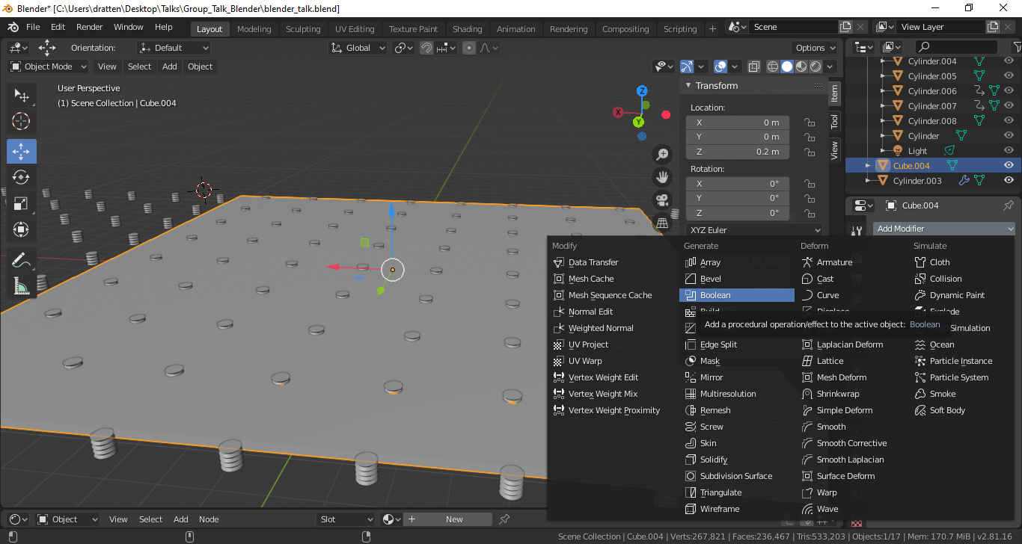
Step 1: Modeling?

Slide 27
Step 1: Modeling?

Slide 28
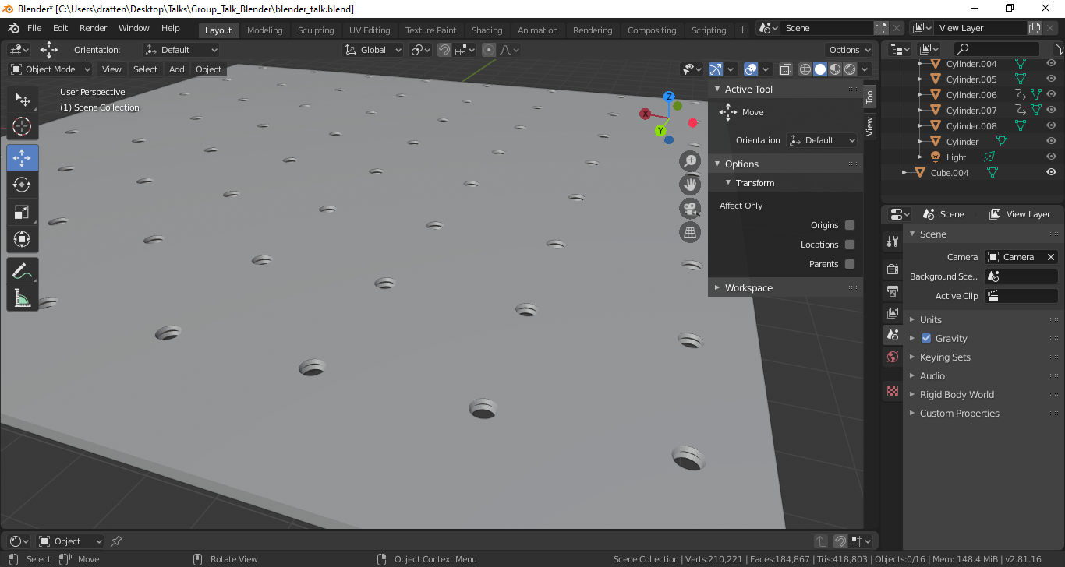
Step 1: Modeling?

Slide 30
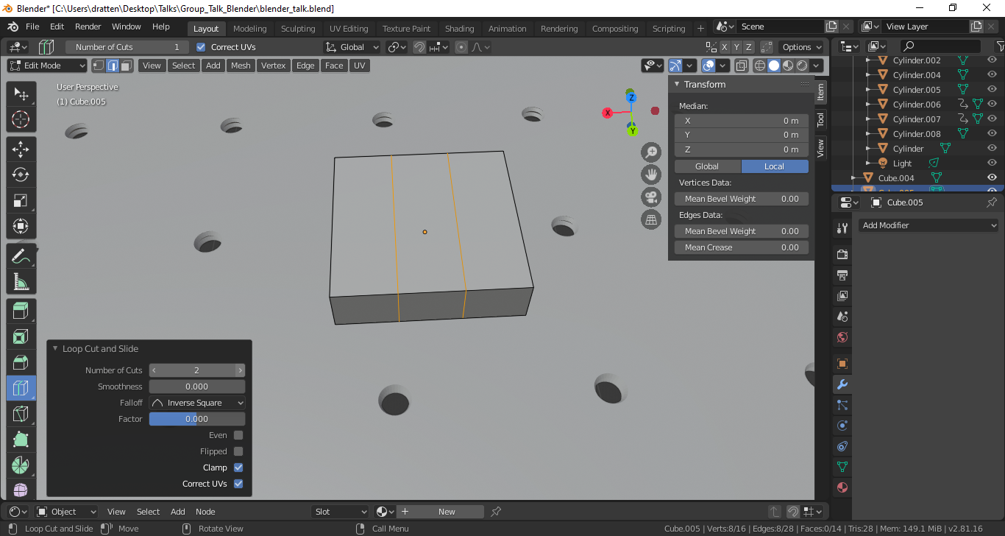
Step 1: Modeling?

Slide 31
Step 1: Modeling?

Slide 32
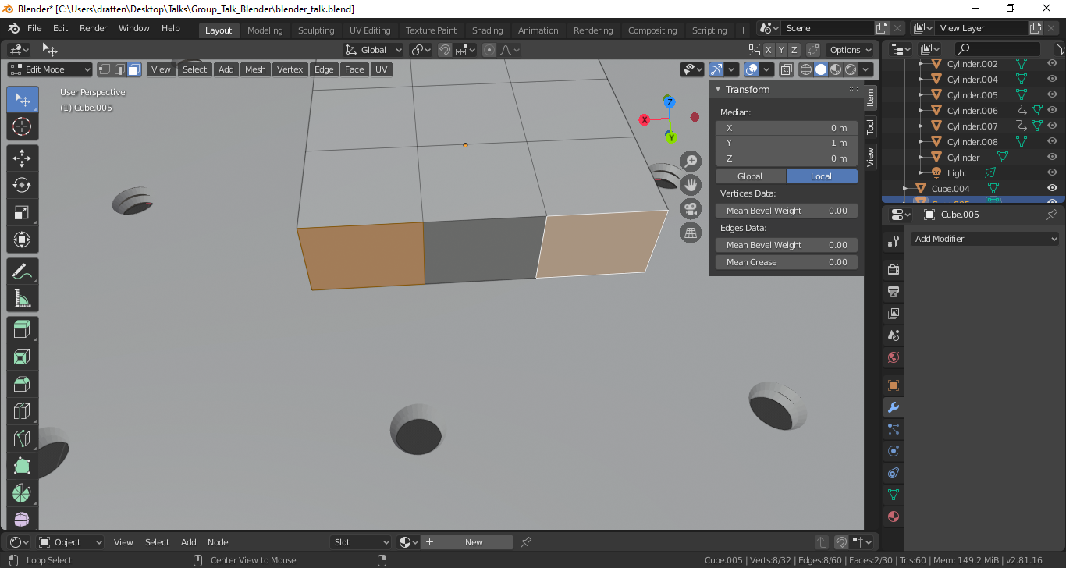
Step 1: Modeling?

Slide 33
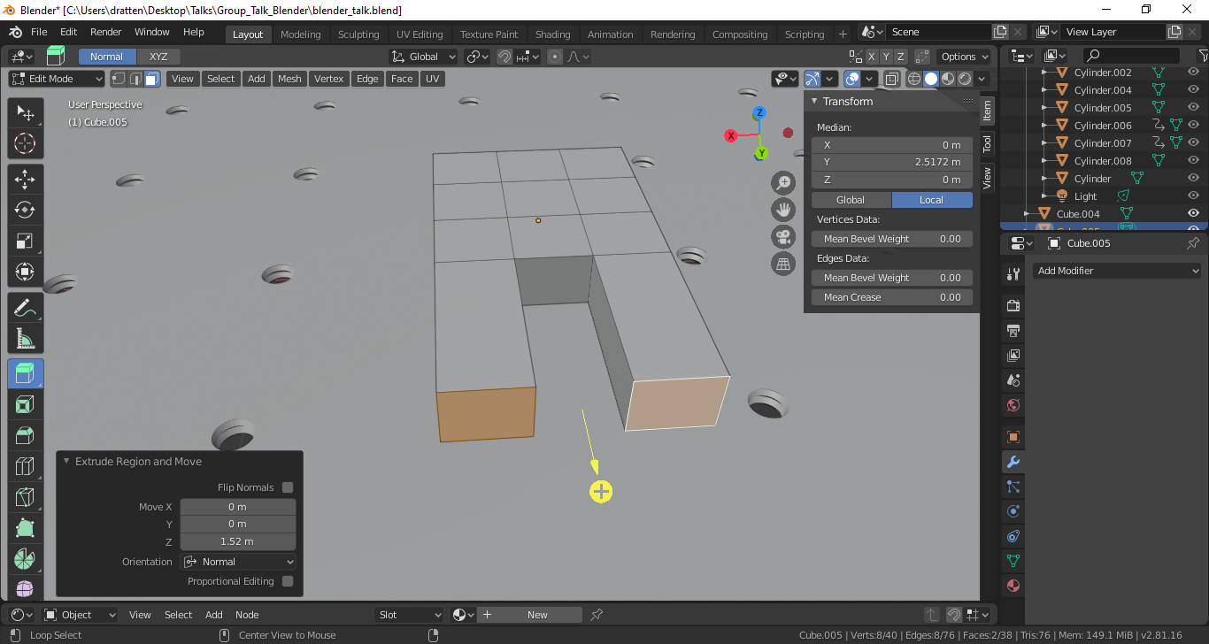
Step 1: Modeling?

Slide 34
Step 1: Modeling?

Slide 35
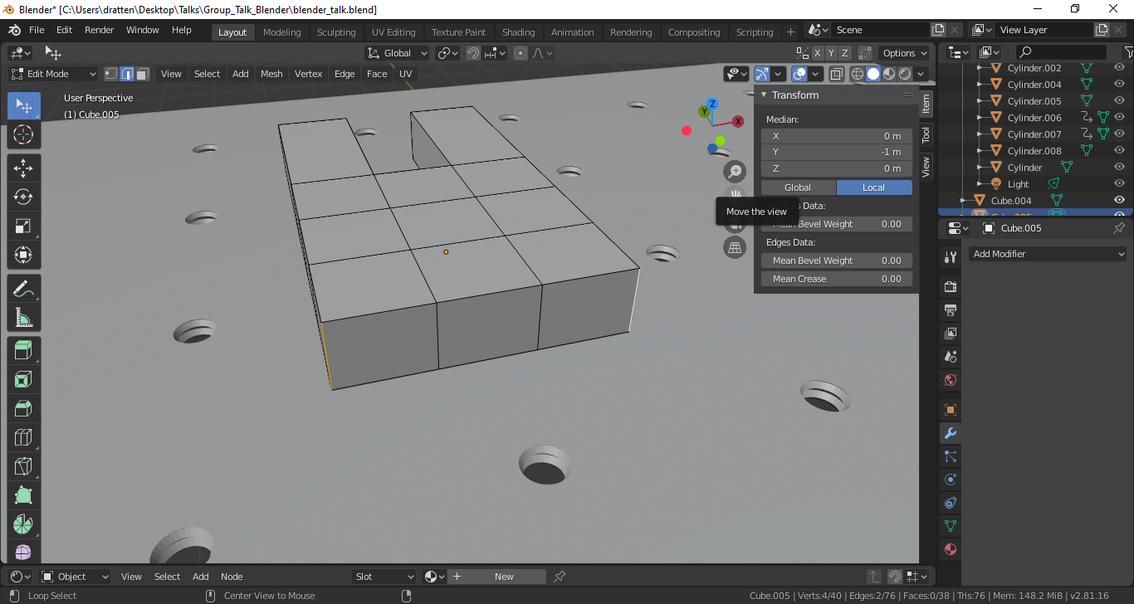
Step 1: Modeling?

Slide 36
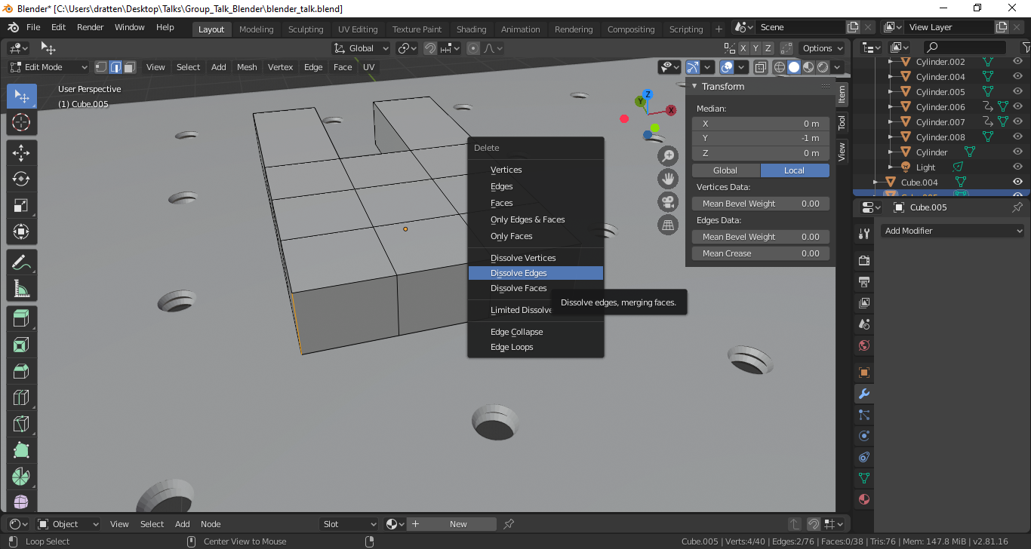
Step 1: Modeling?
Press delete

Slide 37
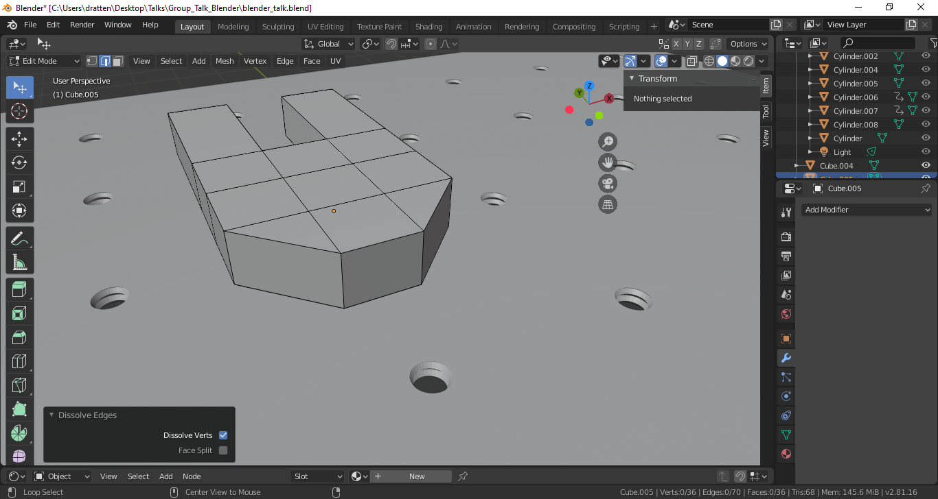
Step 1: Modeling?

Slide 38
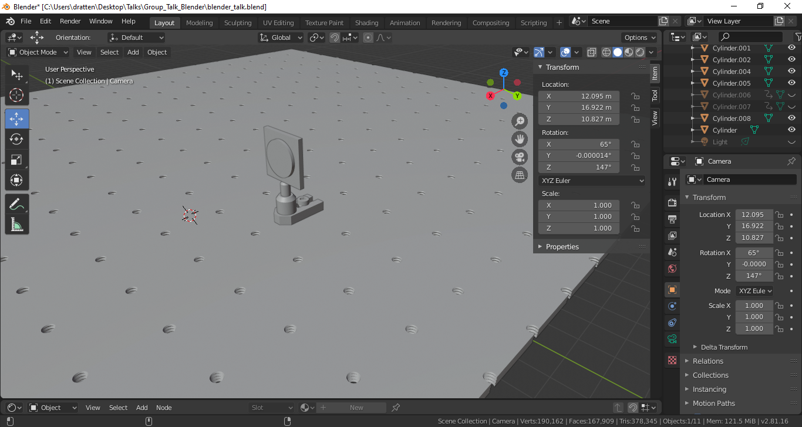
Step 1: Modeling?

Slide 39
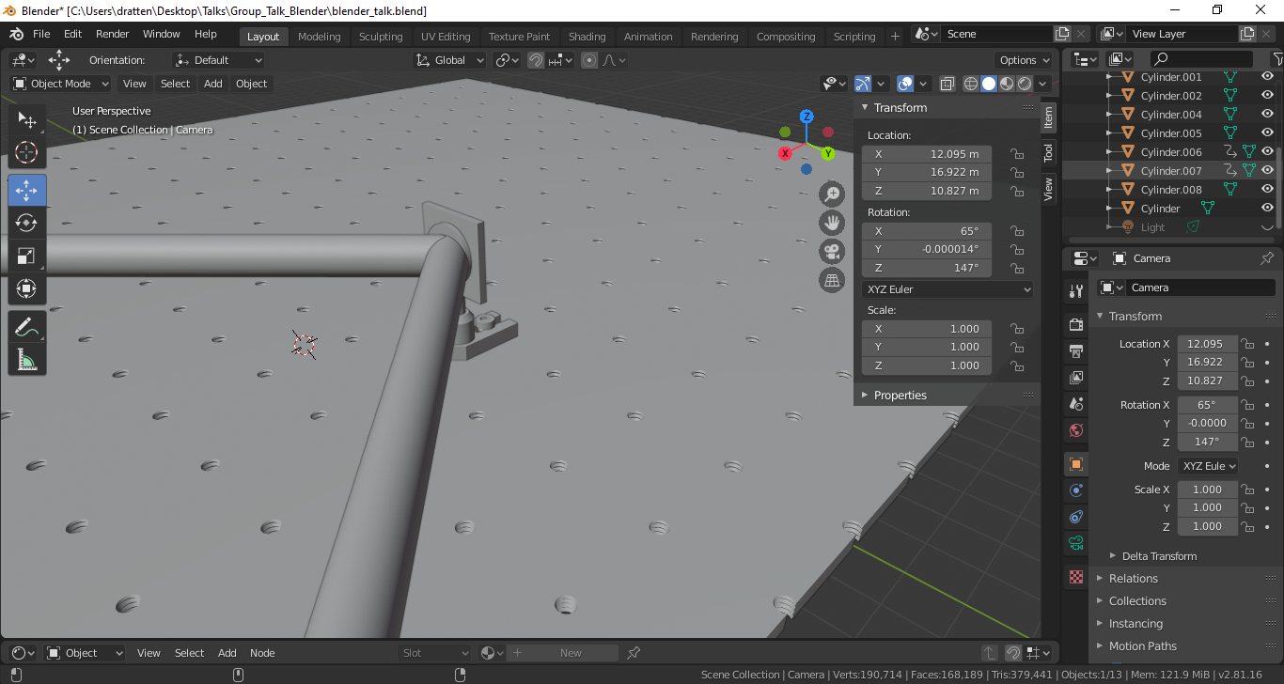
Step 1: Modeling?

Slide 40
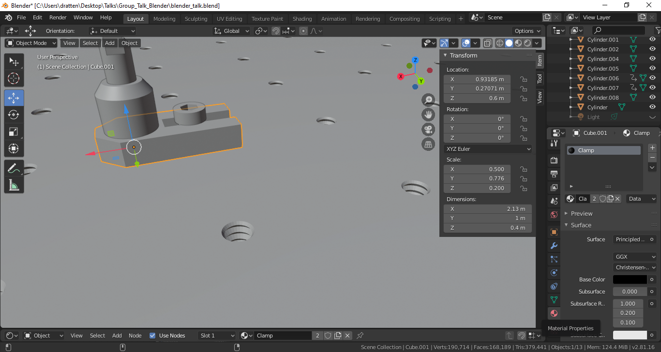
Step 2: Materials

Slide 41
Step 2: Materials

Slide 42
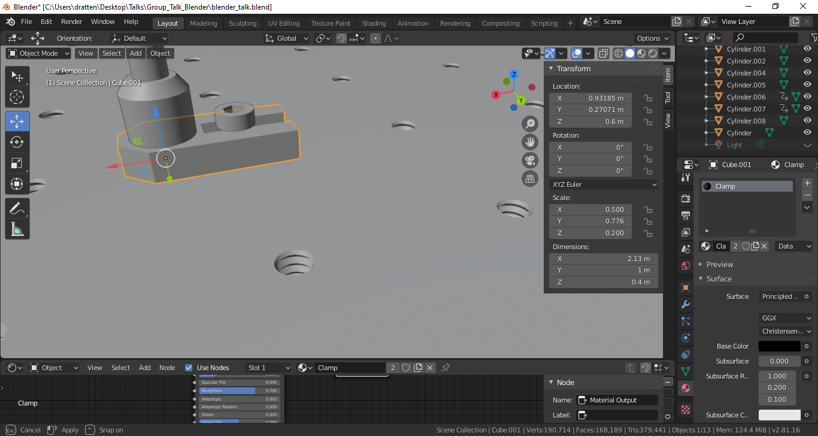
Step 2: Materials

Slide 43
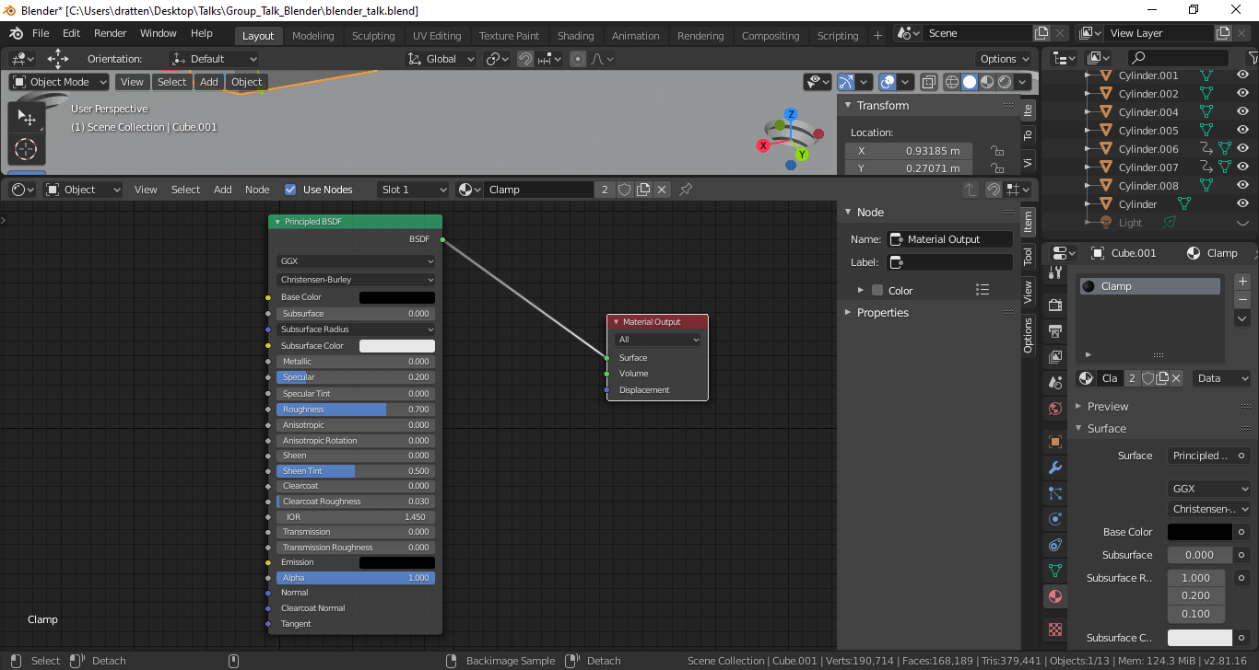
Step 2: Materials

Slide 44
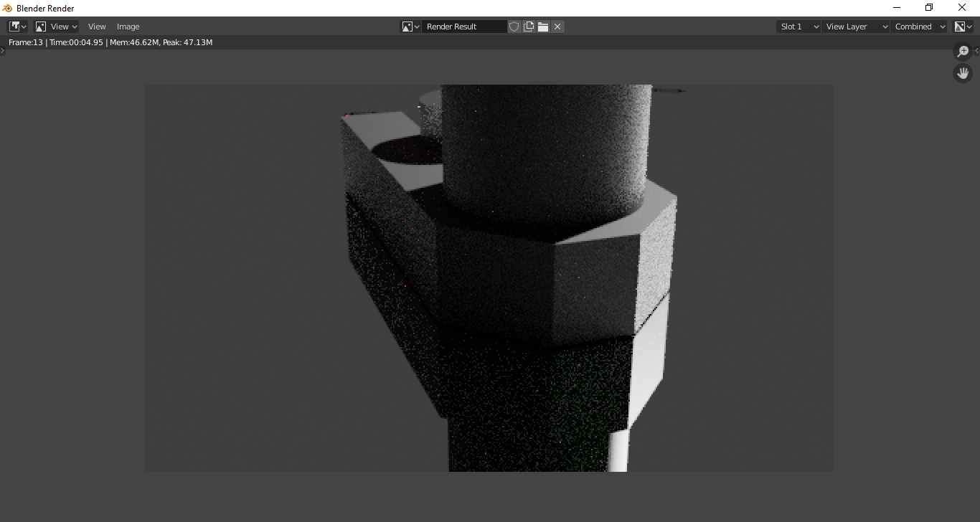
Step 2: Materials

Slide 46
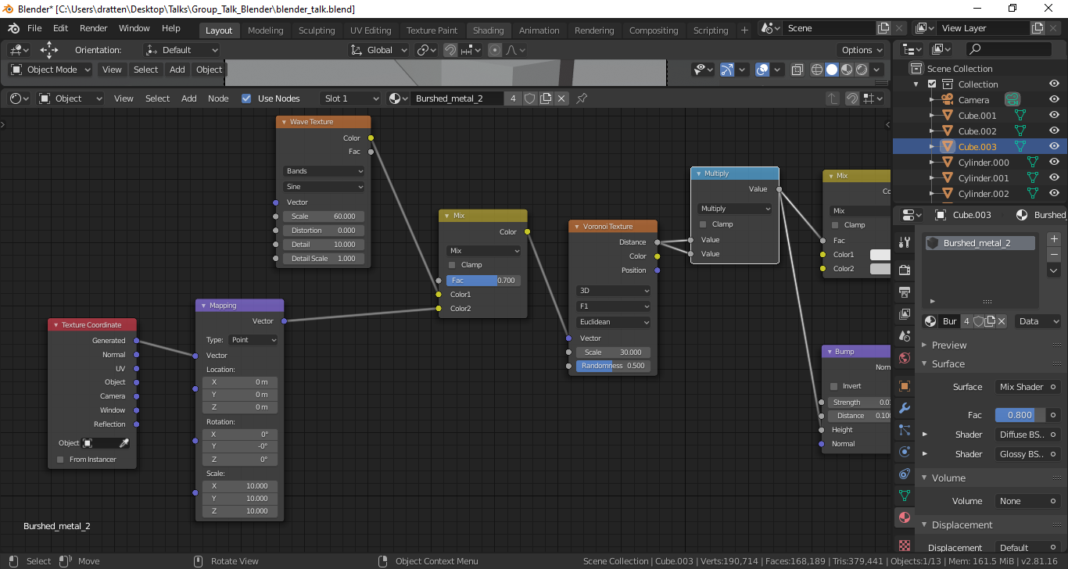
Step 2: Materials

Slide 47
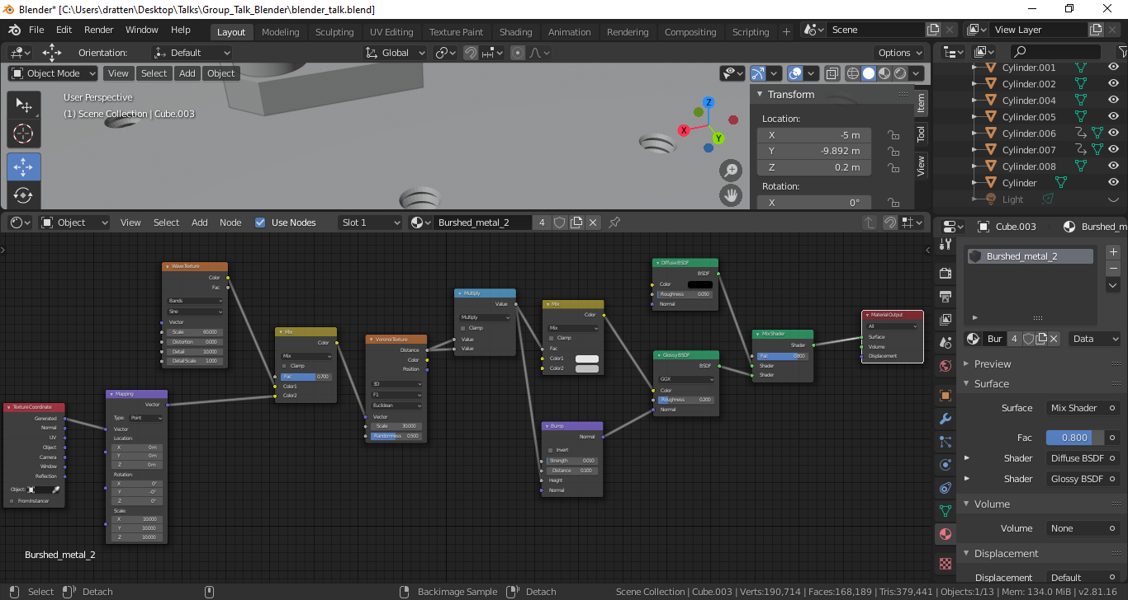
Step 2: Materials

Slide 48
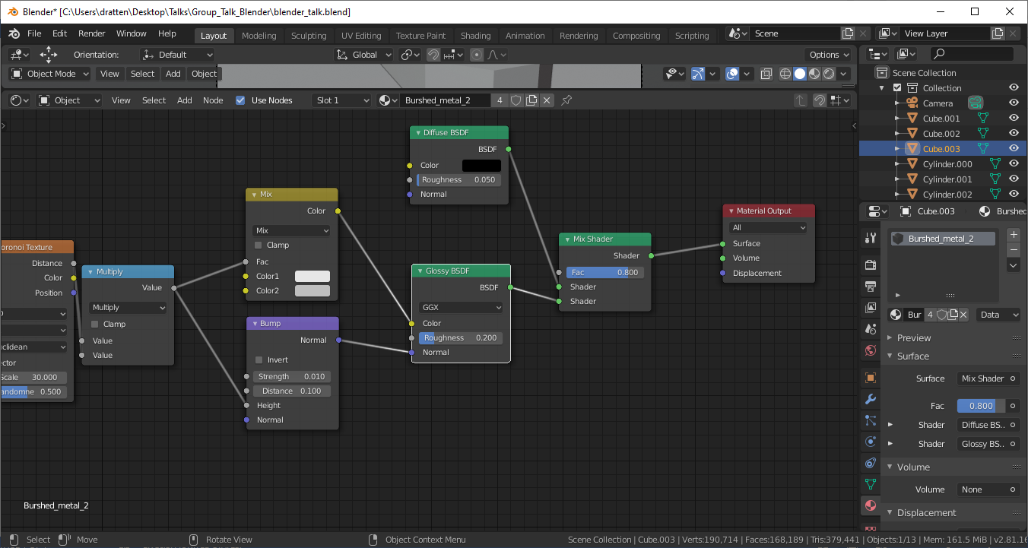
Step 2: Materials

Slide 49
Step 2: Materials

Slide 50
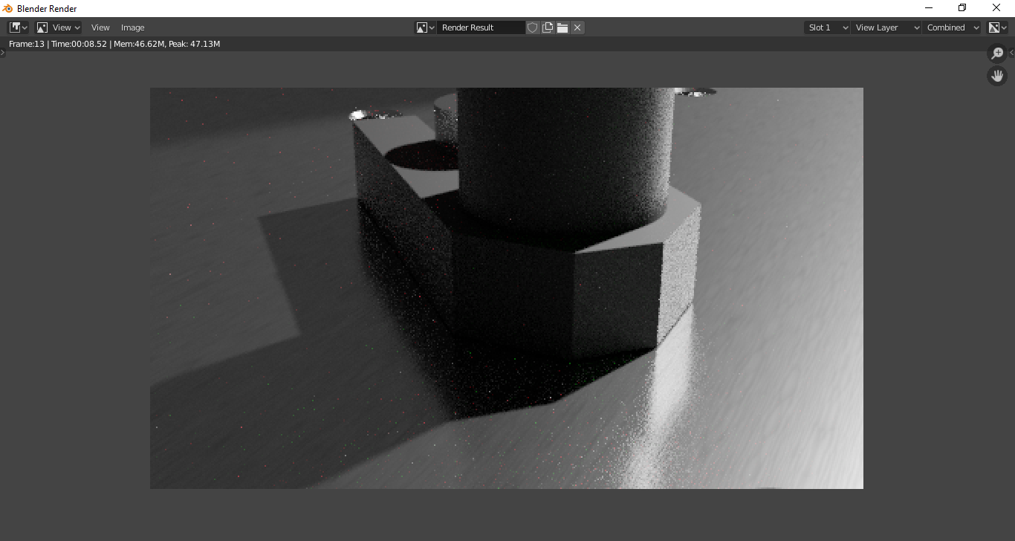
Step 2: Materials

Slide 51
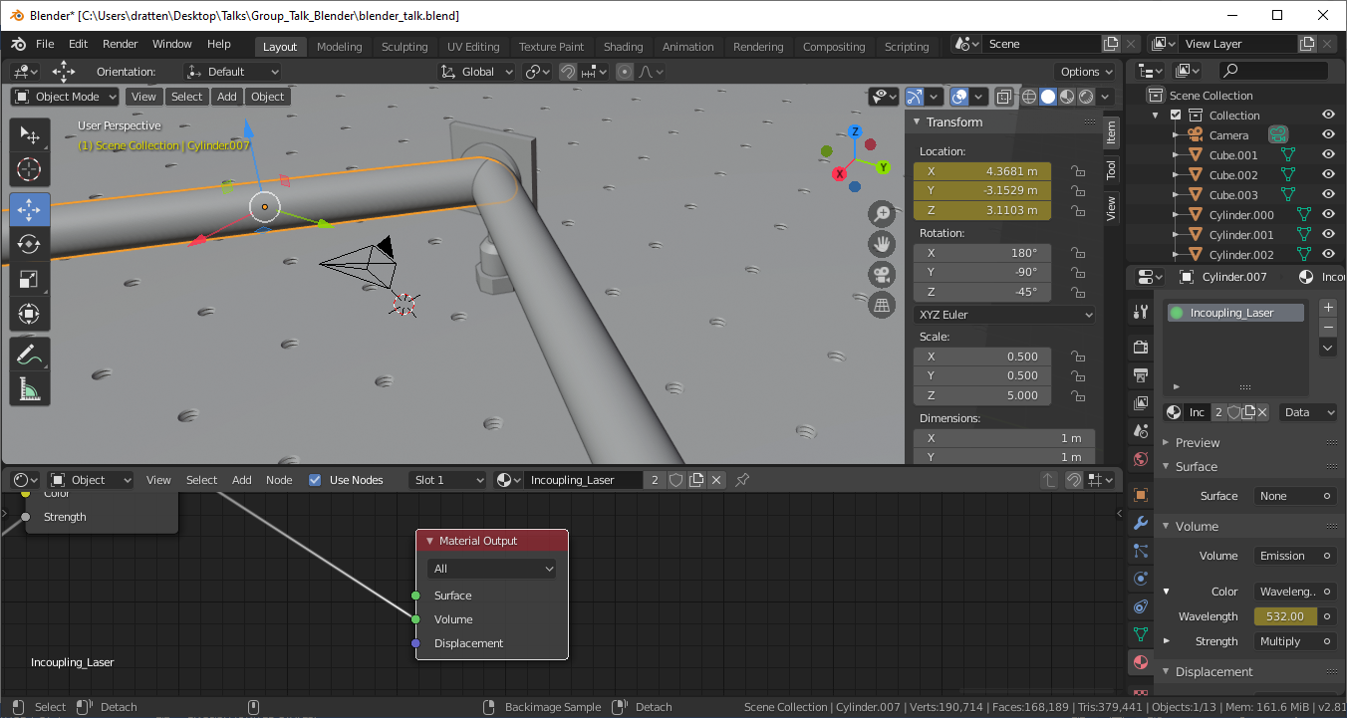
Step 2: Materials

Slide 52
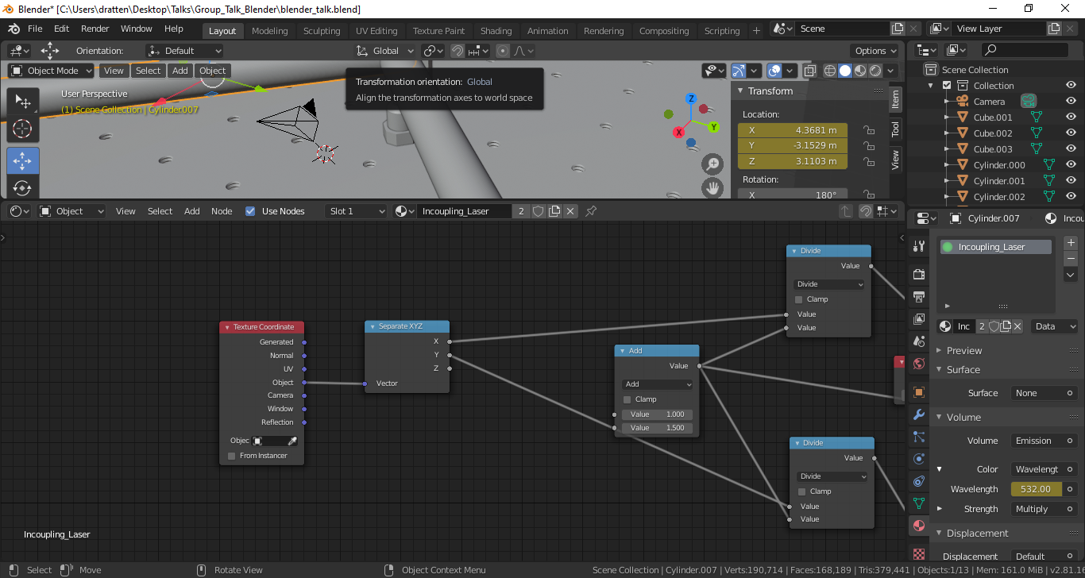
Step 2: Materials

Slide 53
Step 2: Materials
$exp\left(−\left({\left(\frac{x}{0.5} \right)}^{2}+{\left(\frac{y}{0.5} \right)}^{2}\right)\right)$

Slide 54
Step 2: Materials

Slide 55
Step 2: Materials

Slide 56
Step 3: Render Settings

Slide 57
Step 3: Render Settings

Slide 58
Step 3: Render Settings

Slide 59
Step 3: Render Settings

Slide 60
Step 3: Render Settings

Slide 61
Step 3: Render Settings

Slide 62
Step 3: Final Render

Slide 63
Step 4: Animations

Slide 64
Step 4: Animations

Slide 65
Step 4: Animations
Press I to insert Keyframe

Slide 66
Step 4: Animations
Press I to insert another Keyframe

Slide 67
Step 4: Animations

Slide 68
Step 4: Final Animation

Slide 69
Questions?

