Slide 1
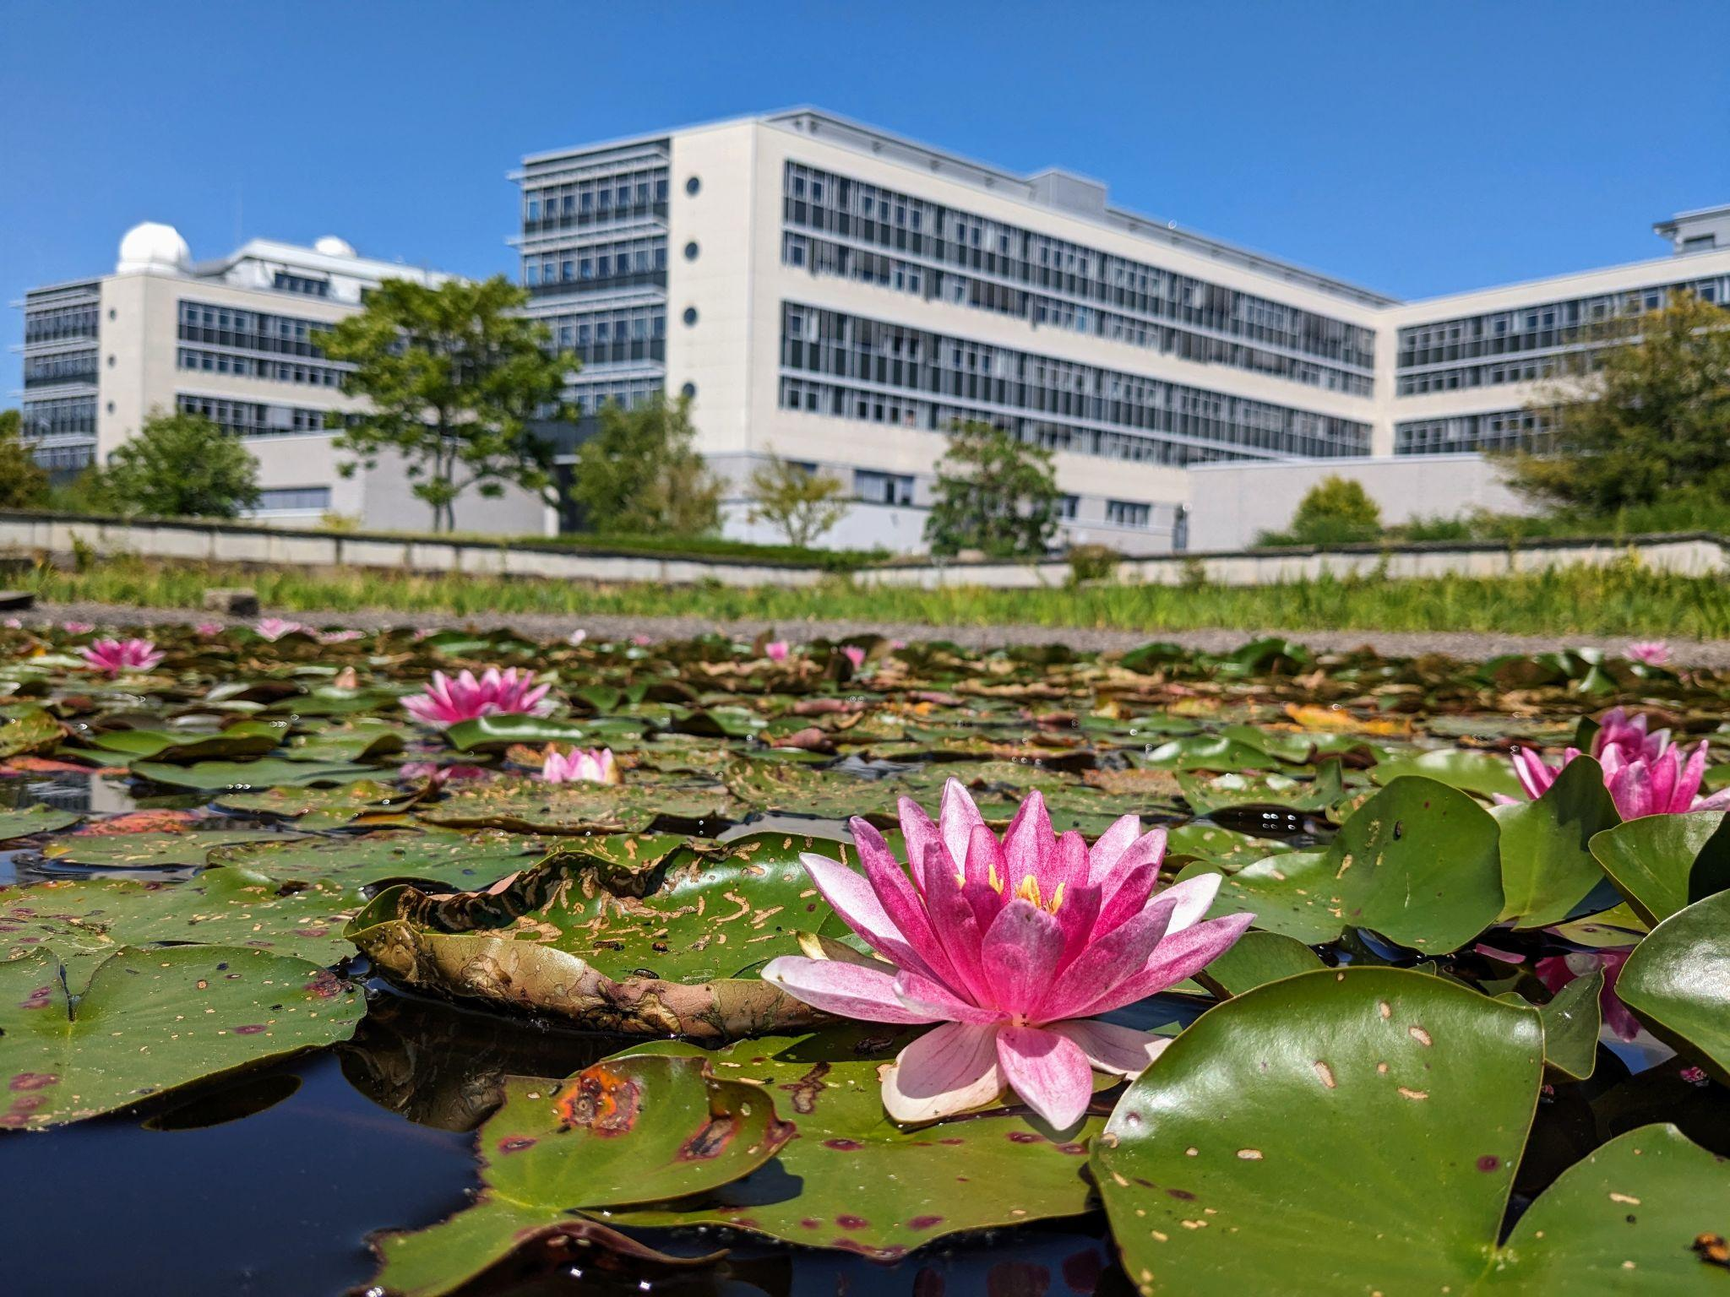
“Hacky” teaching:
teaching by hackathon
Yoav G. Pollack, Anas Hussin,
Jaskaran Singh, Komal Bhattacharyya
Notes:
Spend a couple of minutes introducing myself and a little bit on some of my past work that you might notice peaking in between the lines throughout today’s talk

Slide 2
This is intended as thought provoking…
I am not an expert!!!

Slide 3
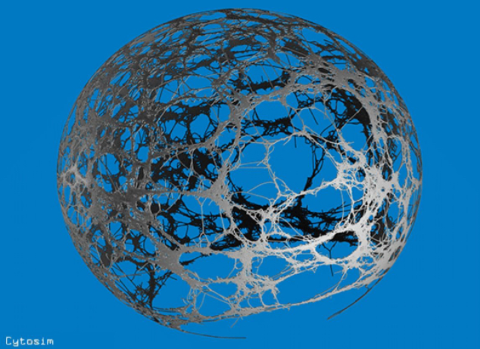
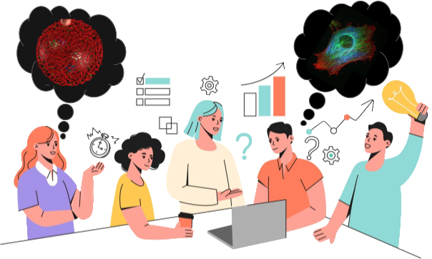
Simulating cytoskeleton with Cytosim
Running a hackathon

Slide 4
What is a hackathon?
A hackathon “is an event where people engage in rapid and collaborative engineering over a relatively short period of time such as 24 or 48 hours. They are often run using agile software development practices…”
Notes:
In contrast to project oriented classes, where for example you reproduce an existing paper

Slide 5
What is a hackathon?
A hackathon “is an event where people engage in rapid and collaborative engineering over a relatively short period of time such as 24 or 48 hours. They are often run using agile software development practices…”
And there’s
Notes:
In contrast to project oriented classes, where for example you reproduce an existing paper

Slide 6
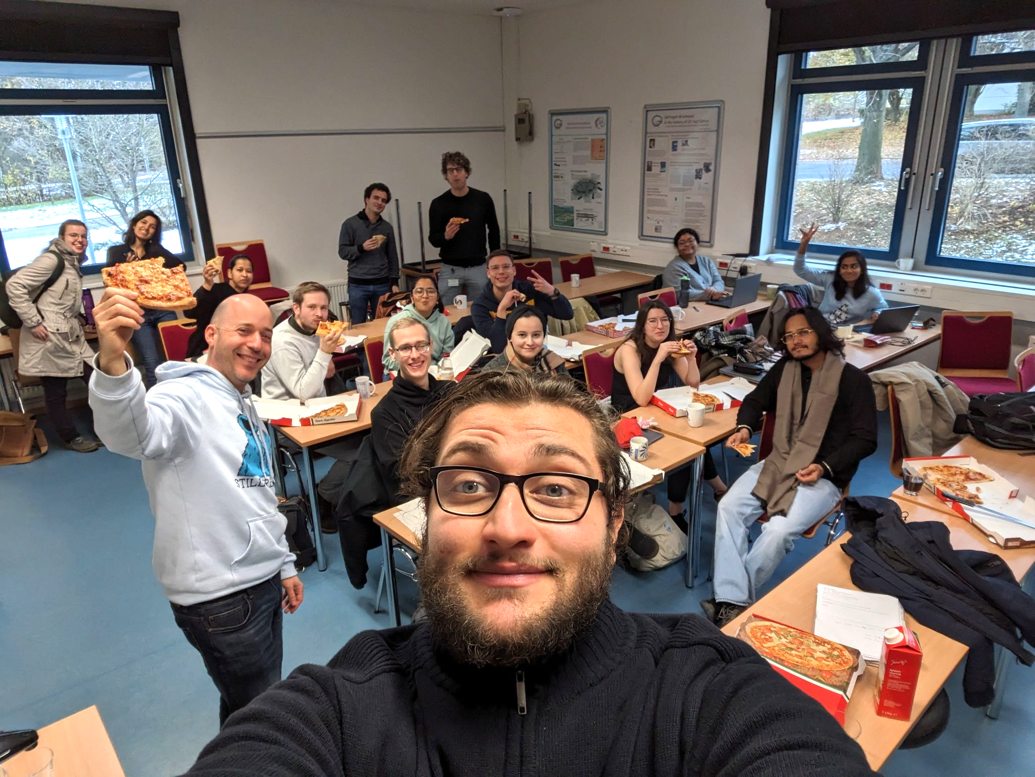

Slide 7
What is a hackathon?
Learn by trying: If someone already knows the result and how to get it, it’s not a hackathon
Notes:
In contrast to project oriented classes, where for example you reproduce an existing paper

Slide 8
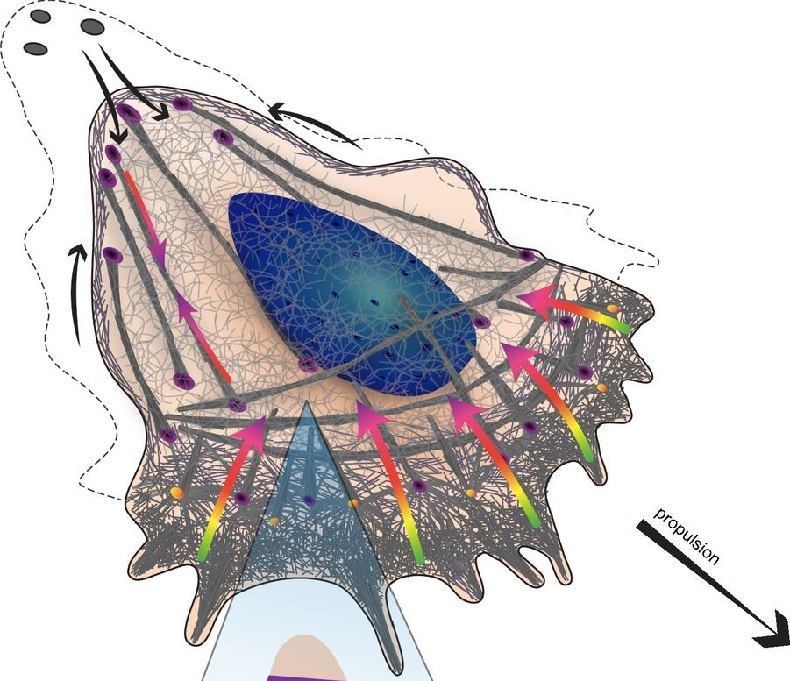
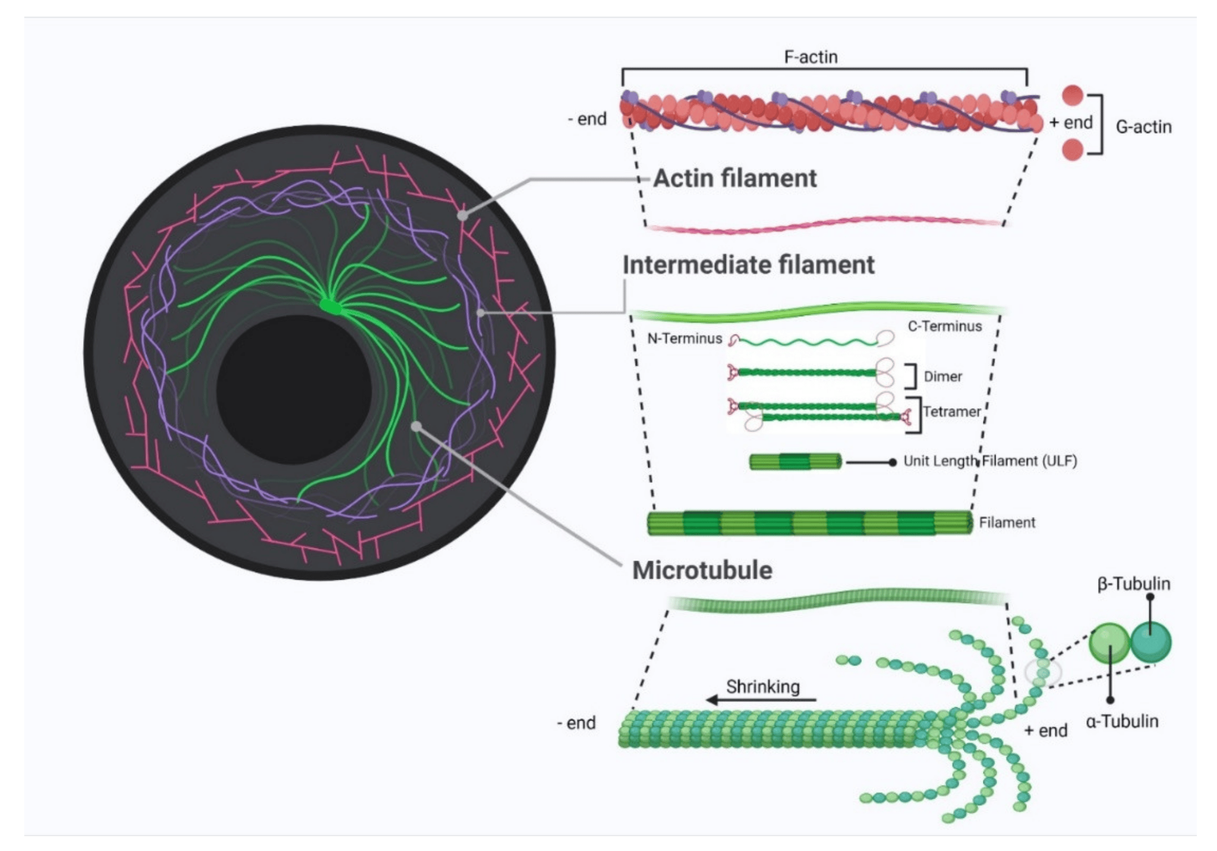
The cytoskeleton
Image: Blanchoin, Laurent, et al. Physiological reviews 94.1 (2014): 235-263
Image: Deng, Shuo, et al. Cancers 14.7 (2022): 1652.

Slide 9
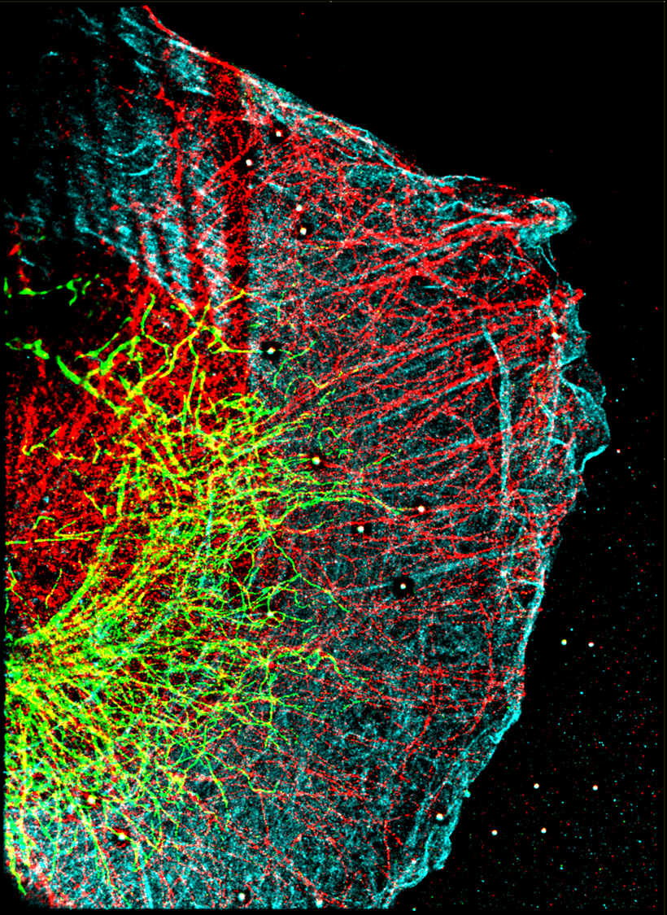
The cytoskeleton
Super-resolution image:
Roman Tsukanov,
Samrat Basak
Image: Deng, Shuo, et al. Cancers 14.7 (2022): 1652.

Slide 10
The cytoskeleton
Super-resolution image:
Roman Tsukanov and Samrat Basak
Image: Blanchoin, Laurent, et al. Physiological reviews 94.1 (2014): 235-263
Image: Deng, Shuo, et al. Cancers 14.7 (2022): 1652.

Slide 11
The cytoskeleton
Super-resolution image:
Roman Tsukanov and Samrat Basak
Image: Deng, Shuo, et al. Cancers 14.7 (2022): 1652.

Slide 12
The cytoskeleton
Super-resolution image:
Roman Tsukanov,
Samrat Basak
…
Image: Deng, Shuo, et al. Cancers 14.7 (2022): 1652.

Slide 13
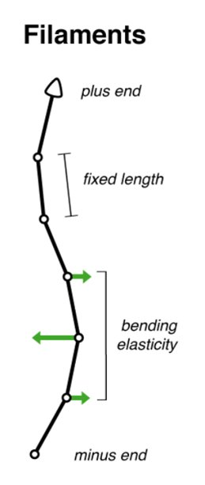
Cytosim
Cytosim Gitlab repo & Nedelec F, Foethke D. New Journal of Physics 9 (11) 427, Nov 2007.

Slide 14
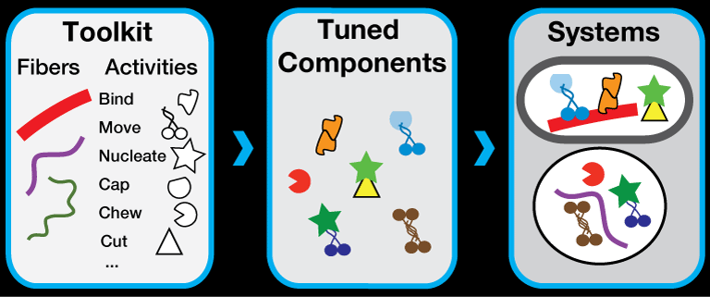
Cytosim
Cytosim Gitlab repo & Nedelec F, Foethke D. New Journal of Physics 9 (11) 427, Nov 2007.

Slide 15
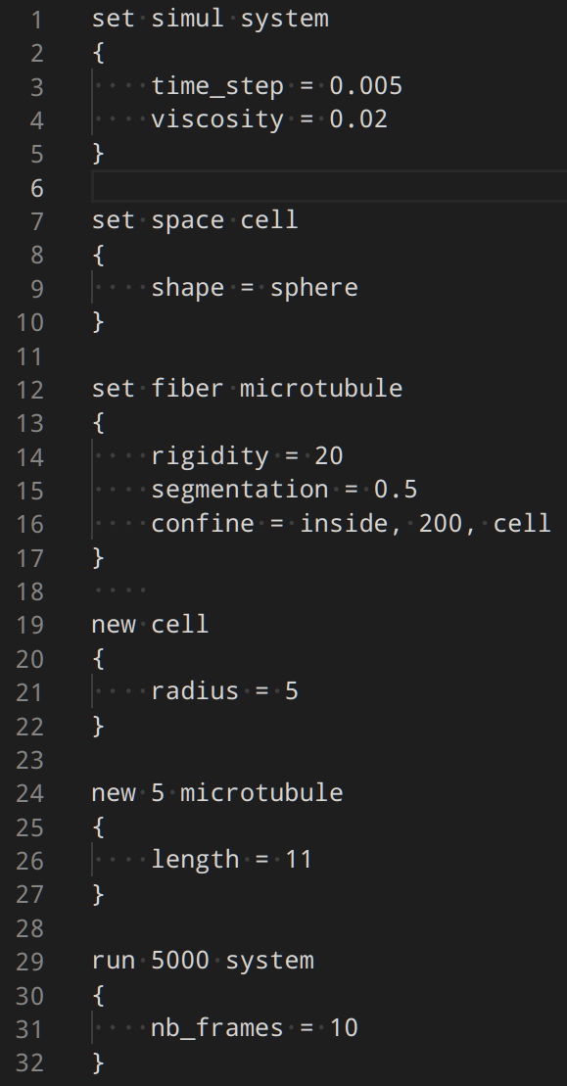
Cytosim - config file
Cytosim Gitlab repo & Nedelec F, Foethke D. New Journal of Physics 9 (11) 427, Nov 2007.

Slide 16
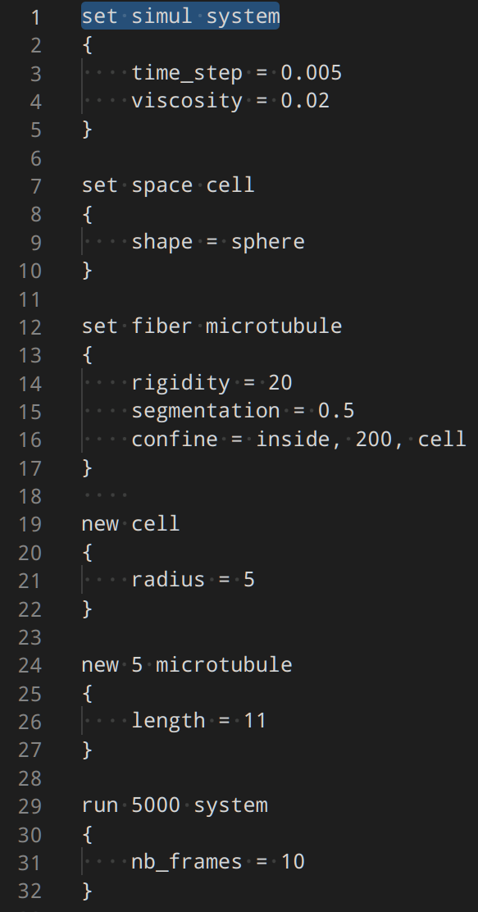
Cytosim - config file
Cytosim Gitlab repo & Nedelec F, Foethke D. New Journal of Physics 9 (11) 427, Nov 2007.

Slide 17
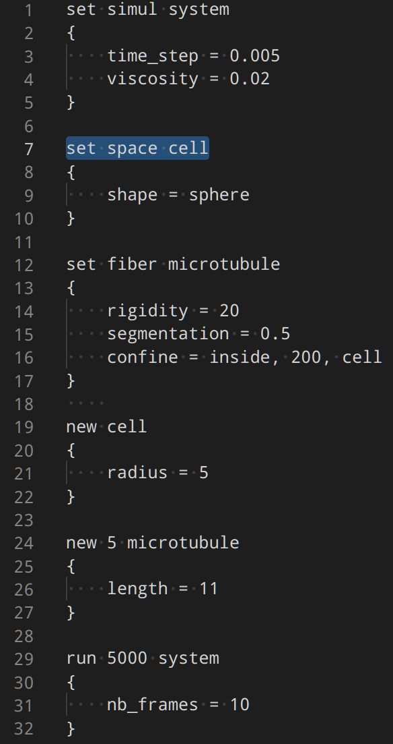
Cytosim - config file
Cytosim Gitlab repo & Nedelec F, Foethke D. New Journal of Physics 9 (11) 427, Nov 2007.

Slide 18
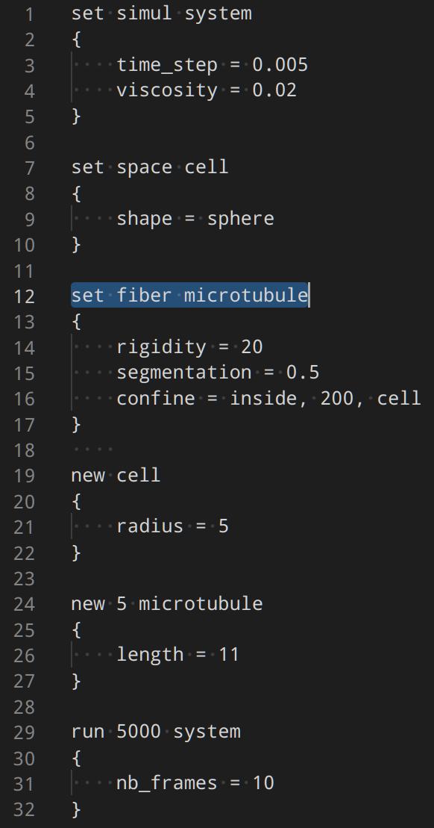
Cytosim - config file
Cytosim Gitlab repo & Nedelec F, Foethke D. New Journal of Physics 9 (11) 427, Nov 2007.

Slide 19
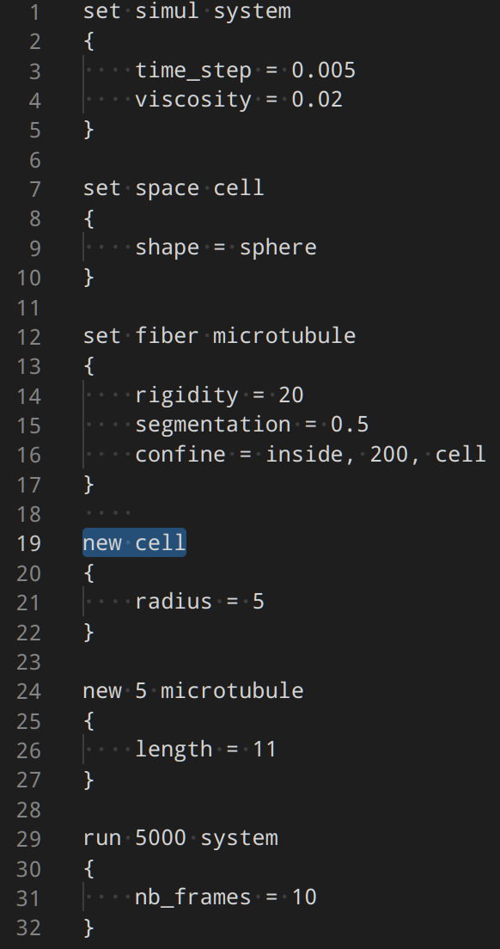
Cytosim - config file
Cytosim Gitlab repo & Nedelec F, Foethke D. New Journal of Physics 9 (11) 427, Nov 2007.

Slide 20
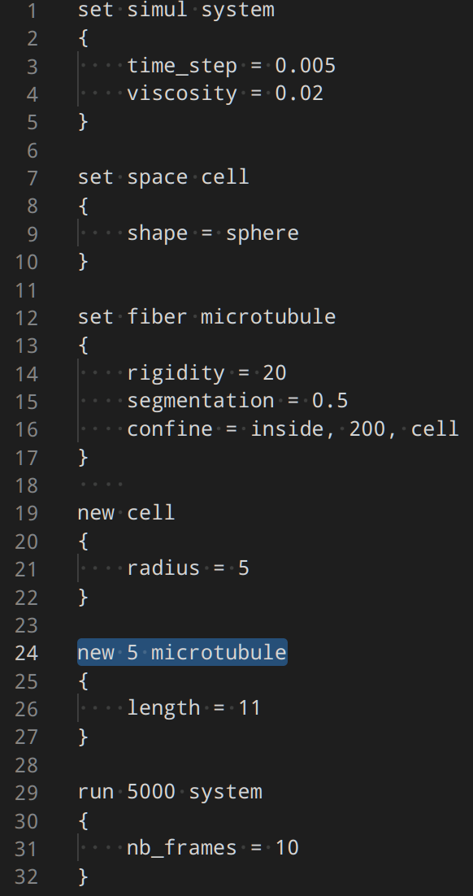
Cytosim - config file
Cytosim Gitlab repo & Nedelec F, Foethke D. New Journal of Physics 9 (11) 427, Nov 2007.

Slide 21
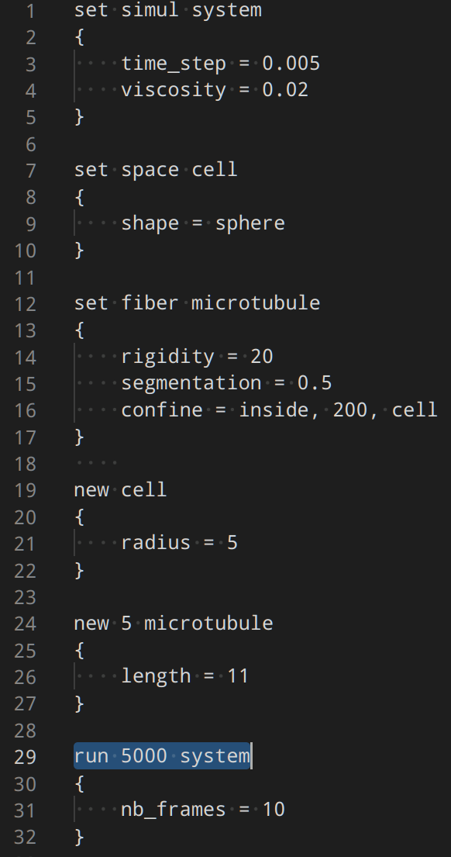
Cytosim - config file
Cytosim Gitlab repo & Nedelec F, Foethke D. New Journal of Physics 9 (11) 427, Nov 2007.

Slide 22
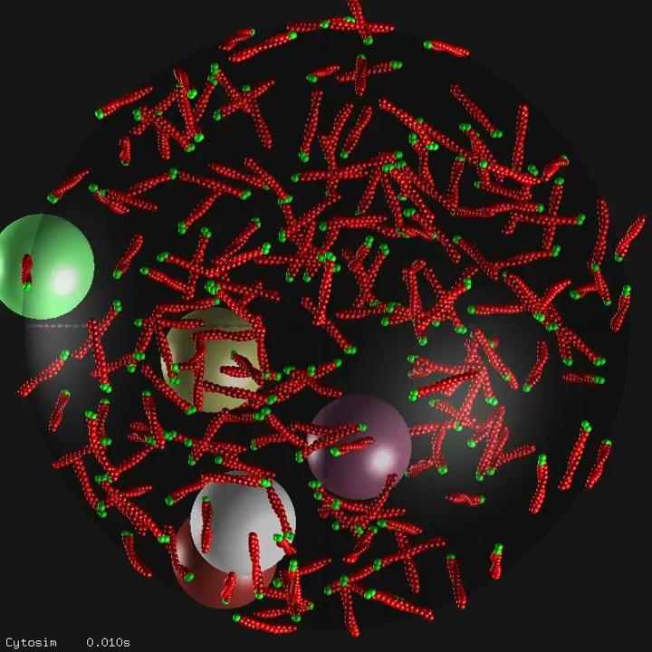
Cytosim Gitlab repo & Nedelec F, Foethke D. New Journal of Physics 9 (11) 427, Nov 2007.

Slide 23
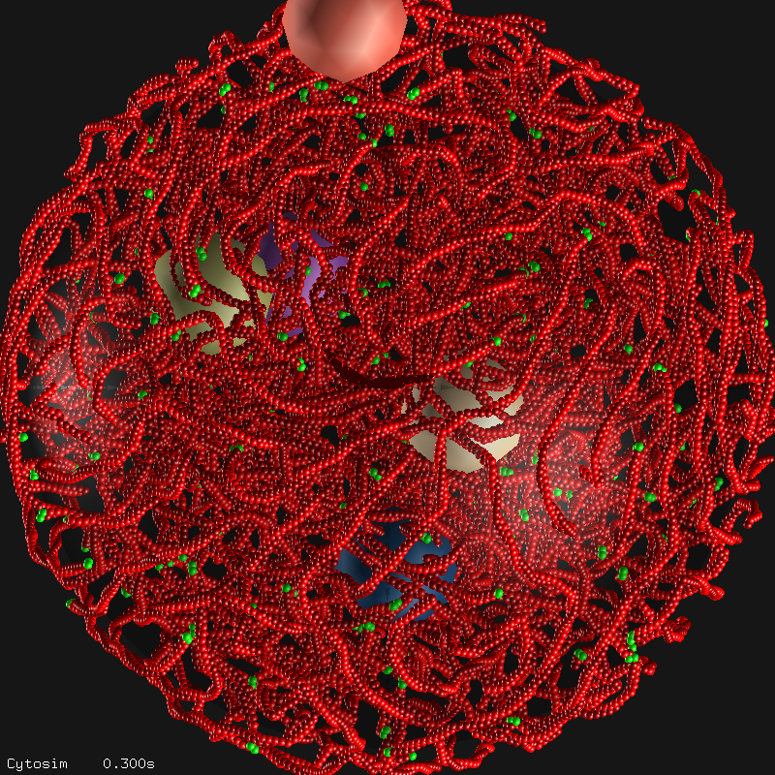
Cytosim Gitlab repo & Nedelec F, Foethke D. New Journal of Physics 9 (11) 427, Nov 2007.

Slide 24
What is a hackathon?
A couple I took part in:

Slide 25
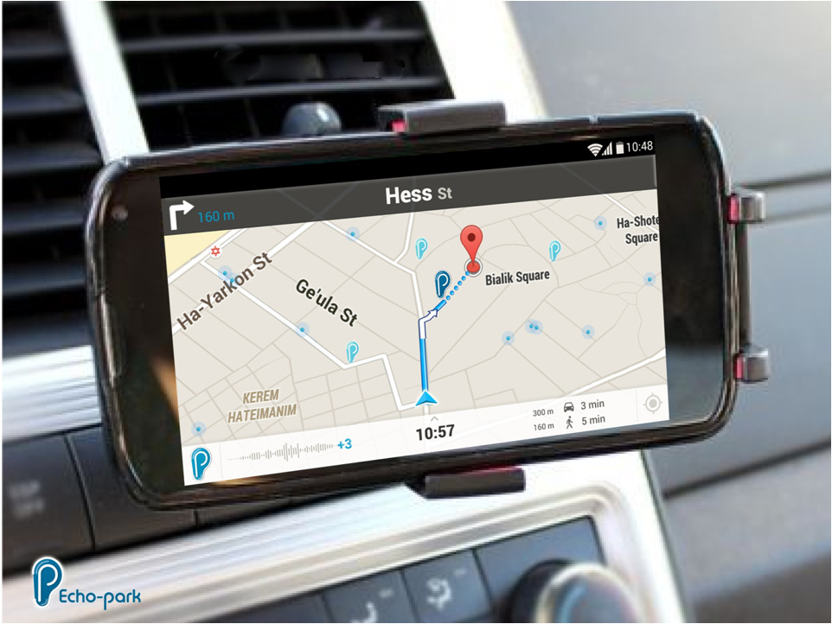
What is a hackathon?

Slide 26
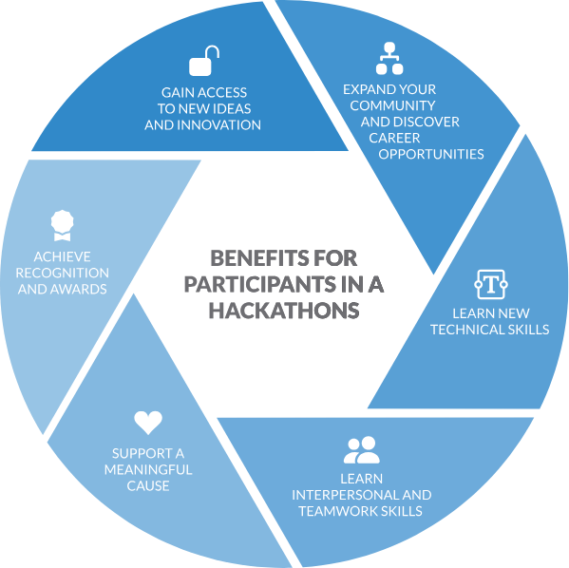
Why hackathon?
For organizers:
Time-condensed teaching
Learn by teaching - but more fun
Test out envisioned projects
Attract students
For participants:
Overcome starting barriers (with minimal investment)
Test if topic/tool is for you
Collaborative learning
Motivating ← ownership of (real) project
Quickly test envisioned projects / Rapid prototyping
credit: brightidea.com
Notes:
Collaborative, fun experience
Agile

Slide 27
Why our hackathon?
Encourage bottom-up collaborations between students of diverse scientific backgrounds
Teach a potentially useful tool
Also for computationally inexperienced
Students are busy

Slide 28
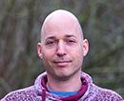
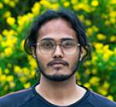
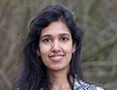
Team
Anas
Hussin
Komal
Bhattacharyya
YGP
Jaskaran
Singh
13 participants

Slide 29
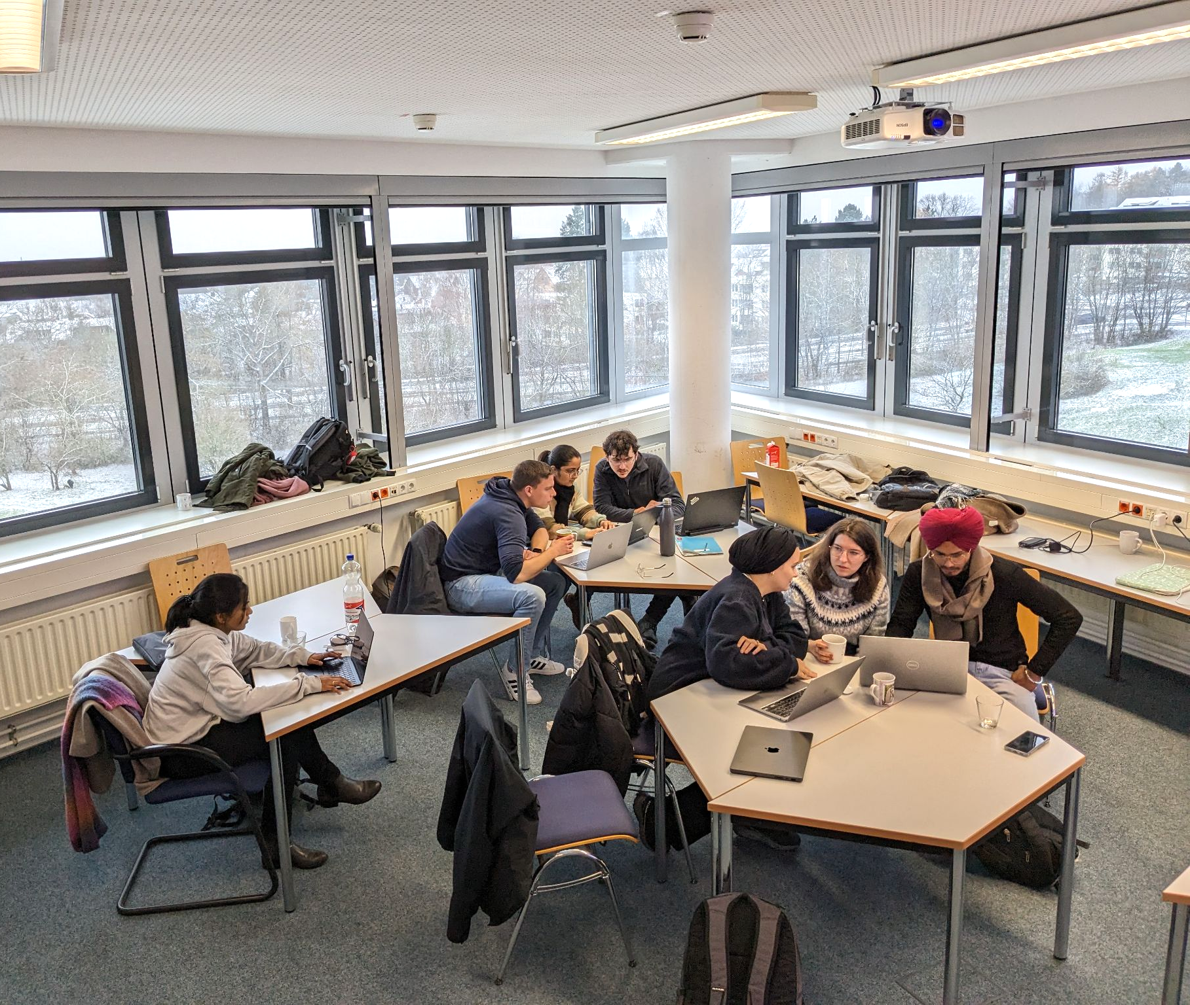
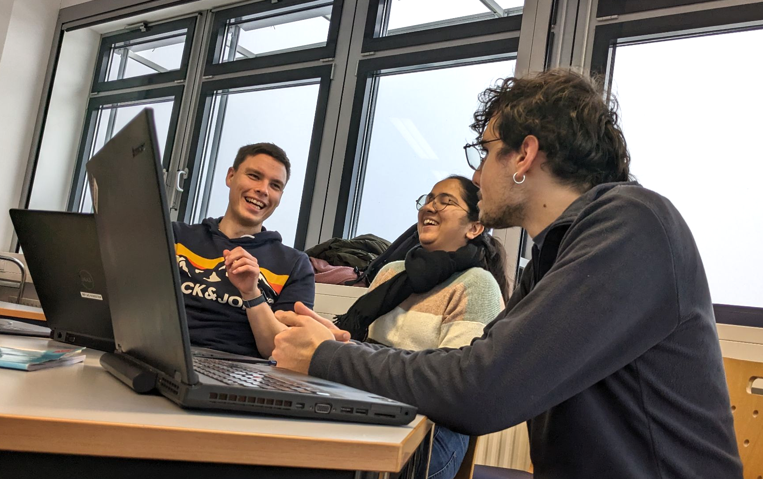
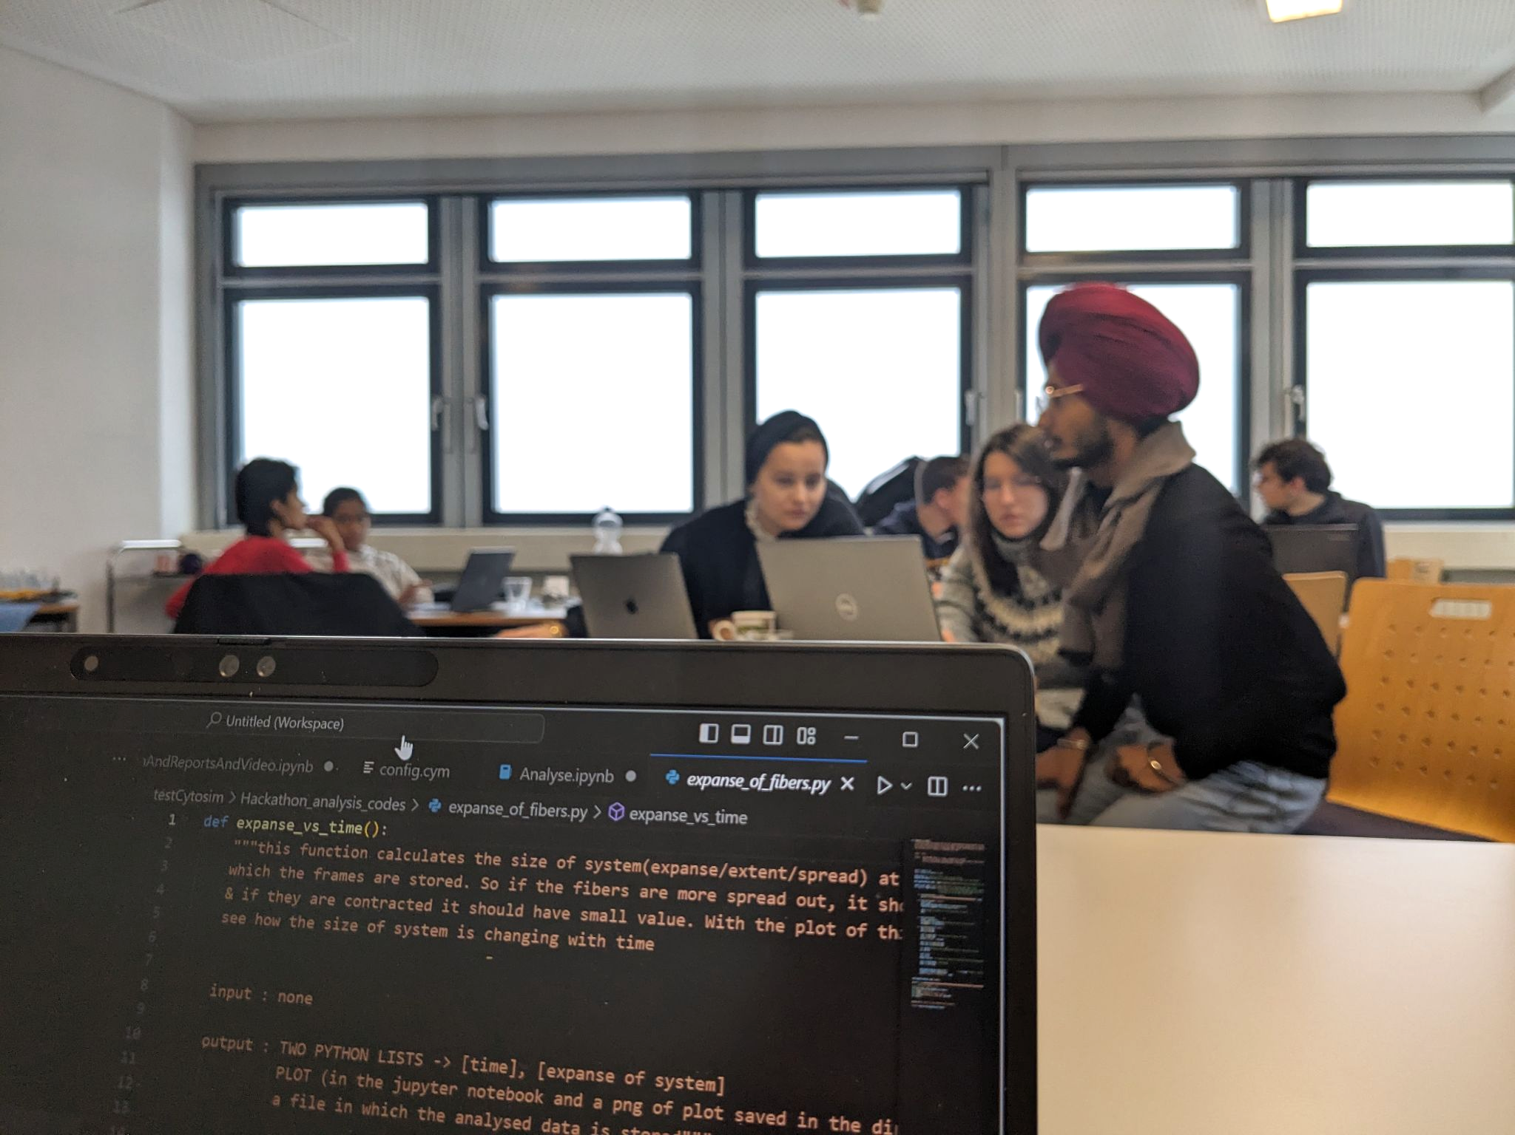
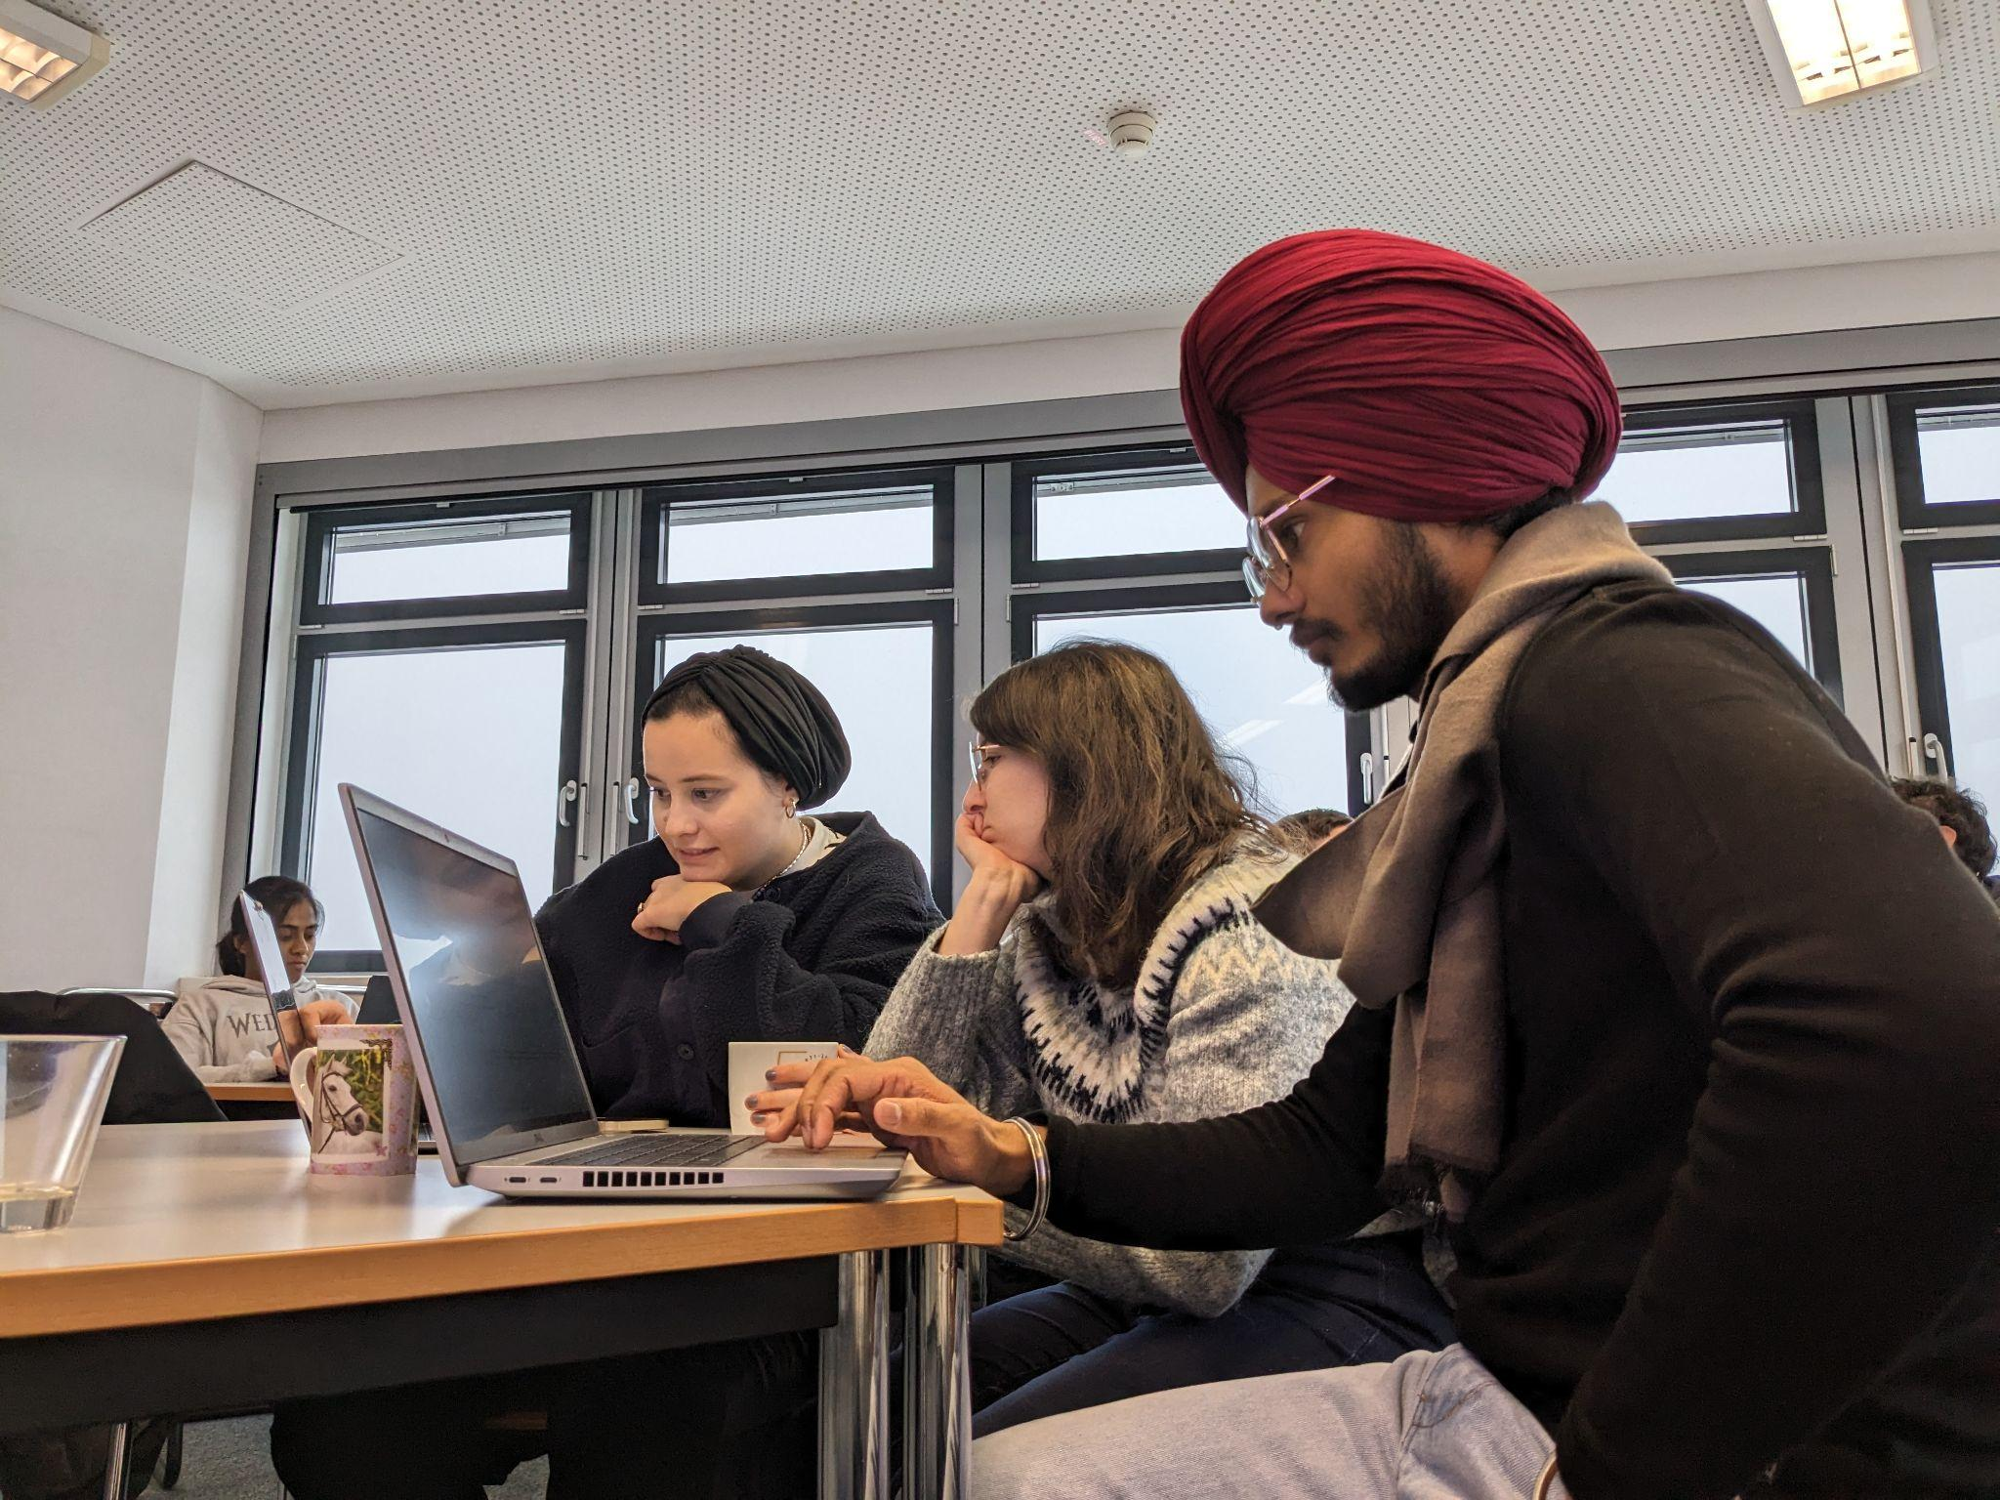

Slide 30
Hackathon plan
01 DEC
08 DEC
Hackathon welcome
Data analysis intro
MD intro
Cytosim intro
Developing PoC
How to - interactive
Free-play time
Team forming, project
conceptualization
Flash presentations

Slide 31
DPG submission
deadline
Hackathon plan
01 DEC
08 DEC
Hackathon welcome
Data analysis intro
MD intro
Cytosim intro
Developing PoC
How to - interactive
Free-play time
Team forming, project
conceptualization
Flash presentations

Slide 32
Non-standard: need to teach some basics
Hackathon plan
01 DEC
08 DEC
Hackathon welcome
Data analysis intro
MD intro
Cytosim intro
Developing PoC
How to - interactive
Free-play time
Team forming, project
conceptualization
Flash presentations

Slide 33
Products (in brief)

Slide 34
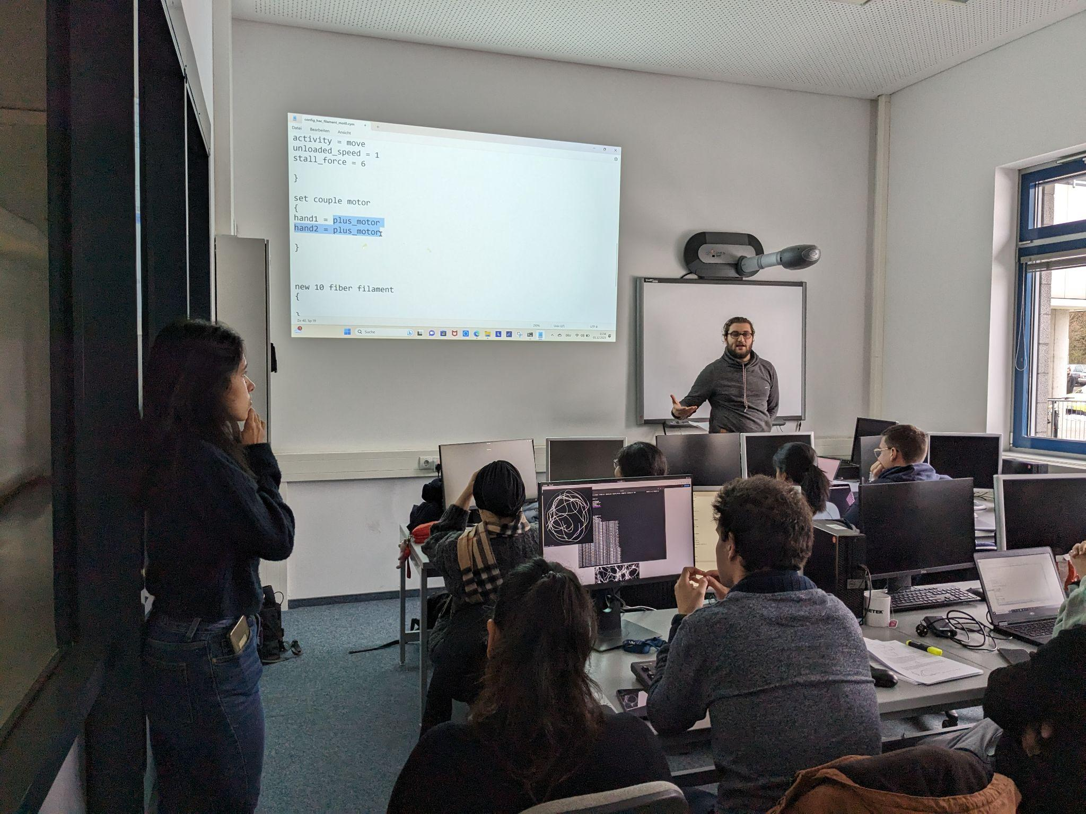
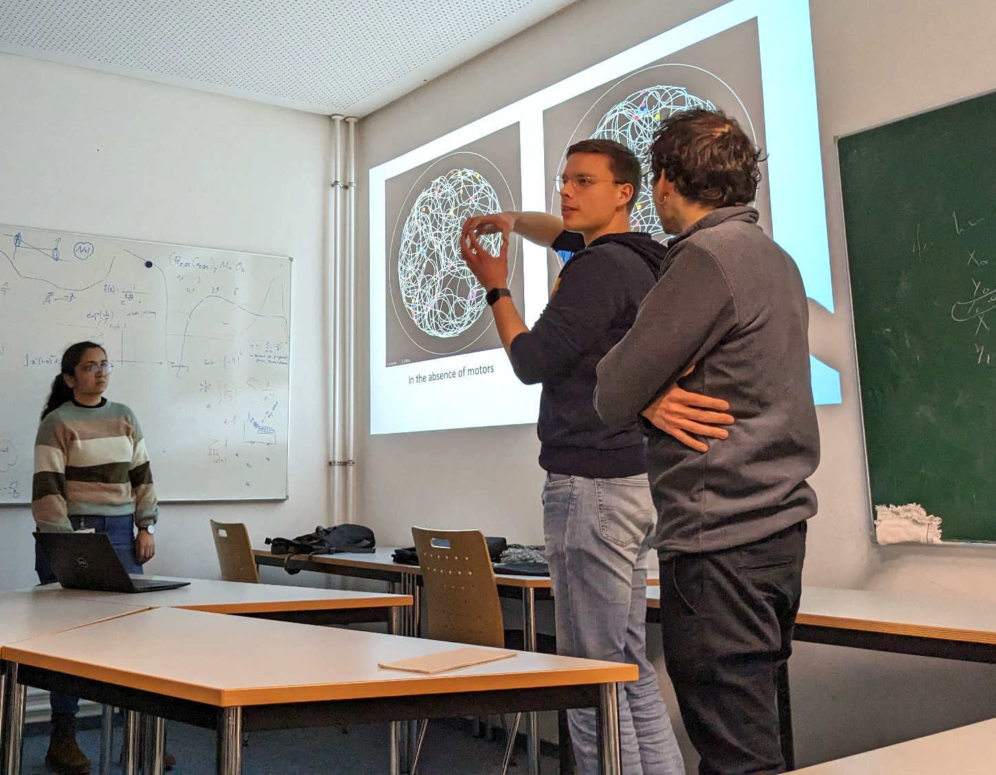

Slide 35
Feedback
I really enjoyed the simulations in group session because it helped us connect our ideas as well as helped become familiar with the software more organically.
I enjoy the approach of trying hands-on the problems we are more interested in
I think the cytosim course was maybe the best course I attended.
Suggest to start with big picture: how running a simulation is like lab work: we first prepare our samples (config file) then initiate the experiment (say, optical tweezers). 😊
…enjoyed the course and appreciate the time you guys spent to make it happen :)

Slide 36
2 minute video: Brief summary of projects
Notes:
(and make sure to get recognition)

Slide 38
What next?
More “start-upy” immersive experience?
24-72 hrs
“secluded” location
Open to (scientific) general audience
have to introduce the cytoskeleton
Suggestions?

